Slide 1
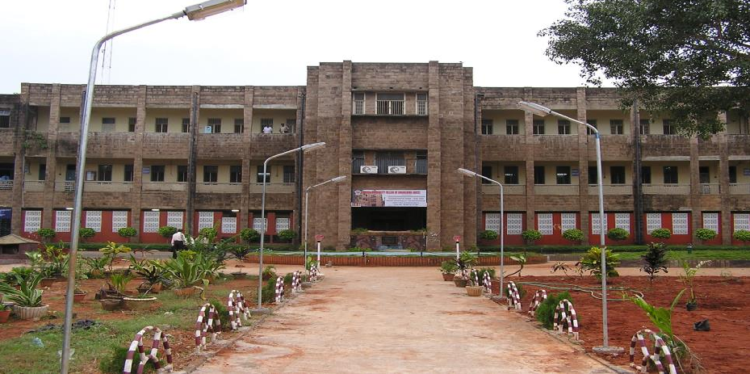
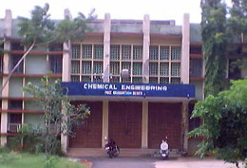
HEARTY WELCOME
Hon’ble Chairperson and Members of NAAC Peer Team
AU College of Engineering
Chemical Engineering UG Building
Chemical Engineering PG Building
Department of Chemical Engineering AUCE, Andhra University, Visakhapatnam

Slide 2
OVERVIEW
Vision & Mission
Department Profile/History/Achievement
Curricular Aspects
Teaching & learning
Research, Innovation and Extensions
Students support and Progression
Infrastructure and learning resources
Governance, leadership and Management
Institutional values and best practices
Progressive Plan
Department of Chemical Engineering

Slide 3
Vision and Mission
DEPARTMENT VISION:
To excel in education, research and consultancy in Chemical Engineering and allied
disciplines and to cater the needs of the industry, academia and society.
DEPARTMENT MISSION:
To train young Chemical Engineers with quality education.
To produce high quality Chemical Engineers with knowledge and skill to meet the technological needs of industry, academia and society.
To develop world class Chemical Engineers with leadership qualities and good communication skills.
Department of Chemical Engineering

Slide 4
QUALITY POLICY
Excellence in teaching, research and consultancy by:
Imparting globally focused education
Creating world-class professionals
Establishing synergic relationships with industry and society
Developing state of art infrastructure and well-endowed faculty
Imparting knowledge through teamwork and incessant efforts
Department of Chemical Engineering

Slide 5
Programme Educational Objectives (PEOs) – UG B.Tech. Programme
Programme Educational Objectives are long term statements to educate the students
about objectives of Chemical Engineering Programme
PEO1:
Graduates will have foundation and knowledge to become successful chemical engineers in industry, academia or government.
PEO2:
Graduates will have foundation and skills for obtaining, applying, and transferring knowledge across disciplines and into emerging areas of chemical engineering and related fields.
PEO3:
Graduates will be effective communicators and have appropriate leadership and teaming skills.
PEO4:
Graduates will have a sense of responsibility and ethical conduct to their profession and an appreciation for the impact of their profession on society both nationally and internationally.
Keywords
Fundamental Knowledge
Lifelong Learning
Ethics and Values
Society Concern
Team work
21st Century Skills
Professional Development
Higher Studies
Department of Chemical Engineering

Slide 6
Department profile & Milestones achieved
All Programmes Approved by A.I.C.T.E
UG & PG Accredited by NBA
UGC-SAP-CAS-I Supported Department
Centre of Excellence under TEQIP phase II
Recognized by the Institution of Chemical Engineers, UK -only Dept. in AP and Telangana
Second oldest Chemical Engineering Department
in India (Platinum Jubilee in 2008)
Construction of Dr. Y.V.S. Murthy Auditorium
in the campus.
UG OBE Programmes NBA initiated
PG OBE Chemical Engg & MPE Programmes
3years NBA Accredited
2009
2023
2014
M.Tech. (CACE) & M.Tech. (IPCE)
2009
2006
B.Tech. (Biotechnology)
M.Tech. (Chemical Engg) & M.Tech. (MPE)
M.Sc (Tech) Chemical Technology
1936
1957
1988
1962
1933
1957
1936
M.Tech. (Biotechnology)
B.Sc (Hons)
Chemical Technology
B.Tech. (Chemical Engineering)
Department of Chemical Engineering

Slide 7
Achievements
Faculty
Students
Awards : 24 Government & Professional bodies
64 students qualified in GATE Best Ranks: 02,13,16,31, Higher Studies 25%
Organized 9 workshops,
2 conferences and Career
Guidance to students
APSCHE Excellence Awards-2023 (Influential Student award)
Publications (182), Patents (13) & Books/Chapters (26)
Ph.D. Awarded: 53
Organized national Student conference RIPPLES-2020
Paper/Poster presentations (25)
Ph.D. Guidance (96) and R&D Projects (2.88 Cr),
Best Paper Awards (3)
Incubation and innovation (EDUMOON), Internships
FDPs (33),
Workshop/Conference (40) ,
NPTEL (02)
Placements (75%)250+ Offers – 2022,120 offers – 2023
Good SFR (19:1) and all faculty
members possesses Ph.D.
Results and Gold Medals (87%, & 9), Certification Courses- Microsoft (40), NPTEL(10)
Department of Chemical Engineering
Notes:
Ms Srilakshmi Sowmya is Chief engagement Officer, Student club, EDUMOON, ahub

Slide 8
Infrastructural Highlights
Department
Ergonomically Designed Infrastructure
Library
Equipment
Aesthetically planned
Class Rooms: 12
1 Fermentor-1 (INR 6L)
Fermentor-2 (INR 9.5L)
Spectrophotometer (INR 5.7L)
HPLC System (INR 10L)
Gen III Micro log System (INR 5.5L)
Digital Bomb Calorimeter (INR 1L)
Equipment to monitor stack
emission (INR 1.5L)
Computer controlled level, flow,
conical tank, spherical tank (INR 12L)
9 PEM Fuel Cell Test Station: 01 (INR 43 L)
10 Electrochemical Work Station:01(INR 24.5 L)
Titles : 1568
Volumes:3113
Ergonomically Designed
Workshop:01
Drawing Hall: 01
Syllabus/Previous
Question Papers
- Ph.D. Theses: 57
Digital Library:
Intranet / internet
facilities
- ChE e-Journals:265
Eco- friendly class rooms & labs
Seminar hall: 01 E Class Rooms: 04
Computer Lab: 02
Library and Reading Room: 01
Research Laboratories-7
UG Laboratories -12
PG Laboratories -06
Department of Chemical Engineering

Slide 9
Faculty Profiles
S.No. | Name | Designation | Qualification | Experience | Specialization
1 | Prof Pulipati King | Professor & Chairman, Faculty of Chemical Engg | Ph.D. | 29 | Industrial Pollution Control Engg, Bio-Chemical Engineering
2 | Prof R. Padma Sree | Professor & Head of the Department | Ph.D. | 29 | Process Control, Modeling, Simulation
3 | Prof G.M.J. Raju | Professor & Chairman, BOS, IIChE Council member, Member Secretary (In-charge) ,APSLET | Ph.D. | 29 | Electrochemical Engg, Corrosion Engg.,
4 | Prof K. Jaya Raju | Professor | Ph.D. | 29 | Biotechnology, Enzyme Production & Optimization
5 | Prof K.V. Ramesh | Professor | Ph.D. | 17 | Process Control, Unit Operations
6 | Prof N. Chitti Babu | Professor & Chief Warden for Boys Hostels | Ph.D. | 17 | Nanotechnology, Pollution Control
7 | Prof D. A. Naidu | Professor & Director, Directorate of Admissions | Ph.D. | 17 | Biotechnology, Pollution Control
8 | Prof V. Sridevi | Professor | Ph.D. | 17 | Environmental Biotechnology, Pollution Control
9 | Prof M.V.V. Chandana Lakshmi | Professor | Ph.D. | 15 | Biotechnology, Production & Separation of biological compounds
10 | Prof V. Meena | Professor | Ph.D. | 15 | Environmental Engg, Biochemical Engg.,
11 | Prof M. Deepa | Professor & Care taker, NCC senior wing (Girls) | Ph.D. | 15 | Hydrocarbon Processing, Pollution Control
12 | Prof G.V.S. Sarma | Professor & Assistant Principal | Ph.D. | 17 | Mineral Engineering, Corrosion Engg
13 | Dr Ch.A.I. Raju | Associate Professor, NSS Program officer &Chief Warden for International Students Hostels | Ph.D. | 17 | Microbial Fuel Cell, Pollution Control
14 | Dr M. Tukaram Bai | Associate Professor & Associate Warden | Ph.D. | 17 | Biosorption, Pollution Control
15 | Dr N.M. Yugandhar | Associate Professor & NCC Officer | Ph.D. | 17 | Biotechnology, Bioprocess Engineering
16 | Dr P. Venkata Rao | Assistant Professor | Ph.D. | 15 | Electrochemical Engg, Corrosion Engineering
17 | Prof G.P. Rangaiah | Visiting Professor (AU) and Emeritus (NUS) | Ph.D. | - | Process Modeling & Optimization

Slide 10
Faculty
Designation
Qualifications
Average Experience:
All faculty possesses Ph.D. Degrees
19 Years
3
3
12
Average SFR:
19:1
Current SFR:
E
19:1
Administrative Positions
7
V, 5
Retention Rate:
100%
Department of Chemical Engineering

Slide 11
Research, Innovations and Extensions
Criterion 3
Department of Chemical Engineering is supported by
S.No. | Project Title & Agency | Fund received (In Lakhs) | Duration
1 | UGC-Bioremediation technologies for treatment of phenol - strategies to enhance process efficiency- Prof. V. Sridevi & Prof. M.V.V.Ch. Lakshmi | ₹ 13.44 | 2015-18
2 | UGC- Special Assistance Programme (UGC-SAP-CAS-I)-Prof. G. M. Jagannadha Raju & Prof.G.V.S.Sarma | ₹ 239.70 | 2016-21
3 | DST-SERB, DST,-Mitochondrial bioenergetics: substrate selection and utilization in normal and diabetic hearts-a theoretical study” Dr.D.Santhosh Kumar | ₹ 35.31 | 2019-21
Total Projects Cost : 288.45 lakhs
Department of Chemical Engineering

Slide 12
Research, innovations and Extensions
Department Research Status
Number of Publications:182
Research, Development & Innovation
SCI/SCIE/SCOPUS/UGC Care /Web of Science Publications
Department of Chemical Engineering

Slide 13
Research, innovations and Extensions
Faculty Research Status
FACULTY PUBLICATION PROFILE:H-INDEX
20
23
16
15
13
13
18
20
19
18
15
8
14
13
7
10
4
8
9
21
6
8
4
7
8
12
14
3
5
8
8
13
16
15
4
5
5
3
7
2
16
21
24
20
3
17
18
2₃
5
3
6
3
3
3
3
3
5
4
4
Department of Chemical Engineering

Slide 14
Academics Highlights
Faculty average age - 51 yrs
Faculty avg. experience – 19 yrs
Maximum experience : 29 yrs
UG labs : 12
PG labs : 6
Research Labs:7
Qualified, Experienced and Motivated Faculty
(16)
Well Equipped Laboratories
(18)
Academics
Results (>87%) and Placements
(> 75%)
Workshops and courses for excellent Skill development
(39)
Consistent results in Final year :more
Value Added Courses :07
than 87%
Guest Lectures: 25
Webinars:02
Certified Mini courses:05
Placements : more than 75% of the eligible students
Department of Chemical Engineering

Slide 15
Initiatives of Ch.E.D:
Partnerships – I-I-I
Thrust Areas of Research
Process Control
Guest lectures (25)
Internships (320)
Biotechnology
Industrial Pollution Control
Thrust Areas of Research – Chemical
Engg.
Industry Institute Relations
Placements: 398 &
Higher Studies 90
Industry
visits (02)
Electrochemical
Engineering
Energy Engineering
Industrial Research and Consultancy in the above said areas
Department of Chemical Engineering

Slide 16
Major / Key Initiatives
Staff
Centric
Student Centric
- Skill Enhancement Training
Free Medical Facility & Insurance
Encouragemet for Higher qualifications
- Add- on courses
Minor & Honor Degrees
Free Medical facility
Remedial Classes
Department of Chemical Engineering

Slide 17
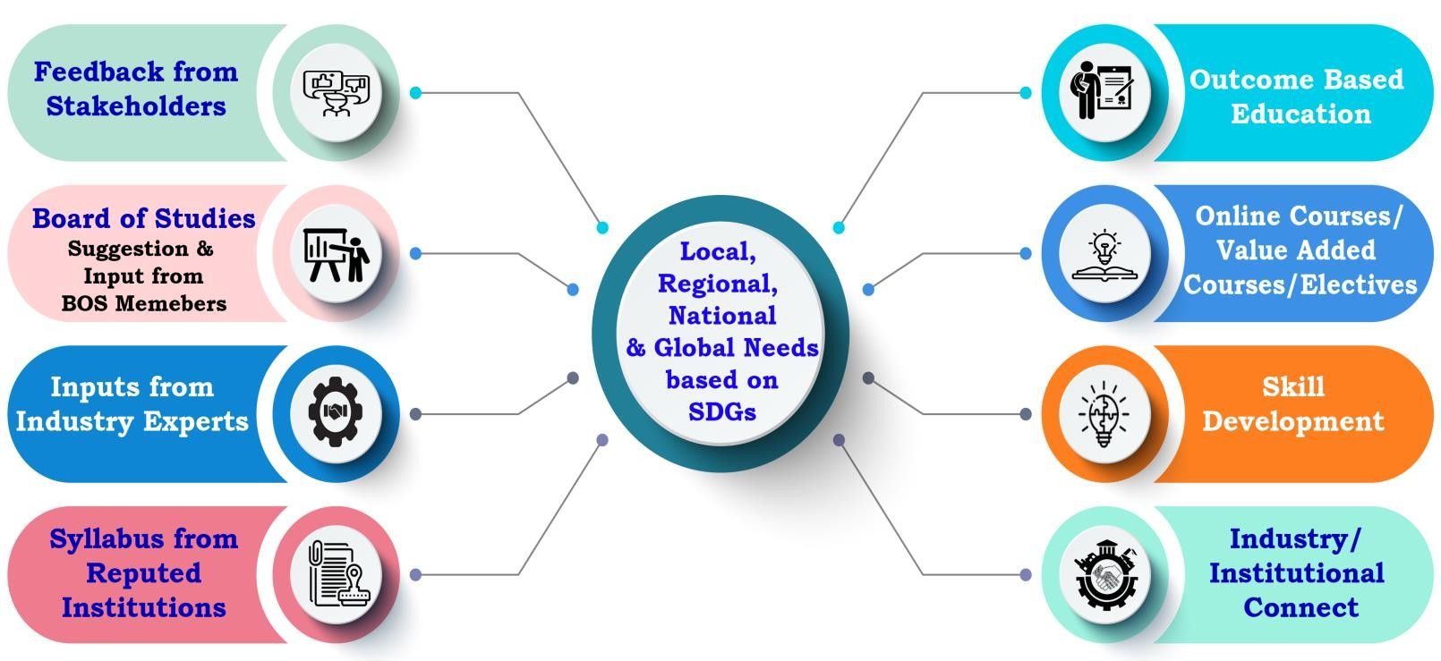
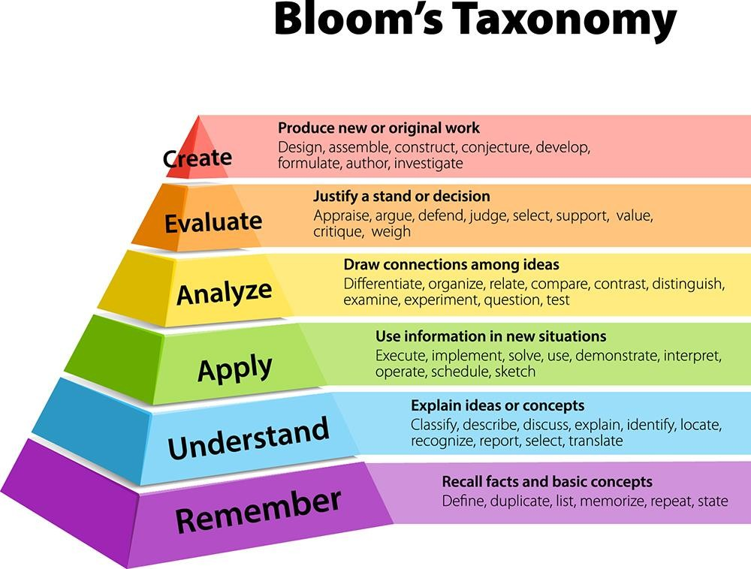
CURRICULAR ASPECTS: CURRICULUM DESIGN & DEVELOPMENT PROCESS
AICTE Model Curriculum
UGC
NEP 2020
Bloom’s Taxonomy
APSCHE
Andhra University
Approved by,
Academic Council & Executive Council
NEP in Curriculum
Multidisciplinary/interdisciplinary- Minor Degrees, Honors Degrees with Specialization
Academic Bank of Credits (ABC)
Skill development
Appropriate integration of Indian Knowledge system (teaching in Indian Language,
culture, using online courses)
Focus on Outcome Based Education (OBE)
Online education: Online Platforms, E-Content , LMS, etc.
Department of Chemical Engineering

Slide 18
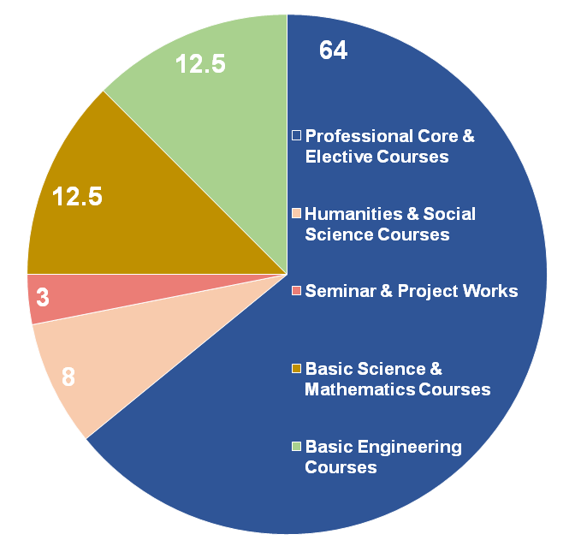
Curriculum Design
BOS of AU-Ch.E.D will prepare the Curriculum Schemes
by referring to
AICTE/UGC/APSCHE/AU/CBCS/NEP Guidelines
Professional body Guidelines such as CMSI/SAE
Current requirements of the Industry
Stake Holders’ Inputs
Revision of the Curriculum
Industry/Market Requirements
Feedback from Stakeholders
Once in an year
Introduction of New Electives
Academic Flexibility
Choice Based Credit System
Credits
2019-20 Batch - 160 (As per AICTE Guidelines)
2021-22 Batch – 160
Courses offered with 1.5/2/3 credits
Additional credits can be earned from add- on courses
Provision for transfer of credits when the students migrate
Honors & Minors
Vertical mobility within the programmes
2022-23 Scheme | Course Components
NEP Compliance
Ability Enhancement Courses
Engineering Science Courses
Programming Language Courses
Emerging Technology Courses
Environment and Sustainability
Mobility
- 160 credits, Trans-, Inter-, Intra-, Cross-
and Multidisciplinary
Department of Chemical Engineering

Slide 19
CURRICULAR ASPECTS (Contd..)
Criterion 1
CBCS/AICTE/APSCHE/OBE Scheme:
Programme Code | Programme name | Year of Introduction | Status of implementation of CBCS/Elective course system (Yes/No) | Year of revision (if any)
3-1-02 3-1-03 3-1-05 3-1-06 | B. Tech. (Chemical Engineering) B. Tech. (Chemical Engineering with Petroleum Engineering as an Elective) B.Tech. (Chemical Engineering with Ceramic Technology as an Elective) B.Tech.(Biotechnology) | 2015-16 | YES | 2019-20
 |  |  |  | 2020-21
3-1-02 3-1-06 | B. Tech. (Chemical Engineering) B.Tech. (Biotechnology) | 2020-21 | YES | 2021-22
3-2-02 3-2-06 3-2-05 3-2-03 | M. Tech.(Chemical Engineering) M.Tech. (Biotechnology) M.Tech. (Industrial Pollution Control Engineering) M.Tech. (Mineral Process Engineering) | 2015-16 | YES | 2019-20
 |  |  |  | 2021-22
Department of Chemical Engineering

Slide 20
CURRICULAR ASPECTS (Contd..)
Programmes offered
B.Tech
2015-16 : Chemical & Biotechnology
2019-20 : Chemical & Biotechnology
2020-21 : Chemical & Biotechnology
2021-22 : Chemical & Biotechnology
M.Tech
2015-16 : Chemical, MPE, IPCE & Biotechnology
2019-20 : Chemical, IPCE & Biotechnology
2021-22 : Chemical, IPCE & Biotechnology
Department of Chemical Engineering

Slide 21
CURRICULAR ASPECTS (Contd..)
Electives/MOOCs Courses
Link to COs
B.Tech -Chemical Engineering
B.Tech -Biotechnology
M.Tech -Chemical Engineering
M.Tech -Biotechnology
M.Tech -IPCE
CBCS : The department offers courses based on CBCS since 2015-16.
Department of Chemical Engineering

Slide 22
CURRICULAR ASPECTS (Contd..)
Integration of Environmental Sustainability and Human values in the Curriculum
Courses like Environmental science and Professional ethics & Universal human values are incorporated in the Curriculum as mandatory courses.
Industrial Pollution Control Engineering, Environmental Pollution Control Engineering are incorporated in the Curriculum as professional/Open electives electives.
In addition to this, exclusive PG program – Industrial Pollution Control Engineering is offered.
Courses with employability/Skill development/value added programmes offered
Student Project works carried out in industries : 61
Department of Chemical Engineering

Slide 23
Feedback
Alumni
43
Recruiters
21
Students
93
NBA
Feedback
for
Improvement
Parents
75
Faculty
160
Feedback system is in place and has an active process of
Collecting feedback from all stakeholders
Analyzing it
Identifying and drawing significant indicators to enhance the learning effectiveness.
Department of Chemical Engineering

Slide 24
Feedback for curriculum collected and analysed report
Criterion 1
Students feedback for curriculum - 93
Parents feedback for curriculum - 75
Faculty feedback for curriculum - 160
Alumni Feedback for curriculum - 43
Employer Feedback on Curriculum - 21
Department of Chemical Engineering

Slide 25
Criterion 1 Feedback for curriculum collected and analysed report (Contd..)
Department of Chemical Engineering

Slide 26
Graduate attributes/ Program outcomes
Engineering Knowledge – Apply the knowledge of mathematics, science, engineering fundamentals, and an engineering specialization to the solution of complex engineering problems.
1
Problem Analysis-Identify, formulate, review research literature, and analyze complex engineering problems reaching substantiated conclusions using first principles of mathematics, natural sciences, and engineering sciences.
2
Design/Development of solutions – Design solutions for complex engineering problems and design system components or processes that meet the specified needs with appropriate consideration for the public health and safety, and the cultural, societal, and environmental considerations.
3
Conduct investigations of complex problems – Use research-based knowledge and research methods
including design of experiments, analysis and interpretation of data, and synthesis of the information to
provide valid conclusions.
4
Modern tool usage – Create, select, and apply appropriate techniques, resources, and modern engineering and IT tools including prediction and modelling to complex engineering activities with an understanding of the limitations.
5
The engineer and society – Apply reasoning informed by the contextual knowledge to assess societal, health, safety, legal and cultural issues and the consequent responsibilities relevant to the professional engineering practice.
6
Department of Chemical Engineering

Slide 27
Graduate attributes/ Program outcomes
Environment and Sustainability – Understand the impact of the professional engineering solutions in societal and environmental contexts, and demonstrate the knowledge of, and need for sustainable development.
7
Ethics – Apply ethical principles and commit to professional ethics and responsibilities and norms of the engineering practice.
8
Individual and teamwork – Function effectively as an individual, and as a member or leader in diverse teams, and in multidisciplinary settings
9
Communication – Communicate effectively on complex engineering activities with the engineering community and with society at large, such as, being able to comprehend and write effective reports and design documentation, make effective presentations, and give and receive clear instructions.
Project management and finance – Demonstrate knowledge and understanding of the engineering and management principles and apply these to one’s own work, as a member and leader in a team, to manage projects and in multidisciplinary environments
10
11
Life-long learning – Recognize the need for, and have the preparation and ability to engage in independent and life-long learning in the broadest context of technological change.
l2
Department of Chemical Engineering

Slide 28
Programme Specific Outcomes (PSOs)
PSO1
The students will be competent in applying basic sciences & chemical engineering principles to multi-disciplinary fields namely Biotechnology, Nanotechnology, Environmental Engineering and Energy Engineering.
PSO2
The students will be able to apply the technical knowledge to solve the problems of chemical and allied industries and society.
Department of Chemical Engineering

Slide 29
CURRICULAR ASPECTS (Contd..)
The COs are assessed as per the Revised Bloom’s Taxonomy level and then, POs and PSOs are evaluated for ensuring the better learning levels with COs, POs and PSOs.
The Course Outcomes are then mapped onto POs and PSOs.: CO-PO mapping
Chemical Engineering
Biotechnology
Department of Chemical Engineering

Slide 30
CO, PO & PSOs Assessment Process and Tools
CO
Assessment (A)
PO, PSO
Assessment
Direct Assessment (From CO Attainment)
(80% Contribution)
Indirect Assessment(20% Contribution)
Direct Assessment 80%
Alumni Survey
External Assessment (University Exam)
70%
Graduate Exit Survey
Internal Assessment
30%
Employer Survey
PO& PSO Assessment Process
CO Assessment Process
Department of Chemical Engineering

Slide 31
Numerical Methods in Chemical Engineering
COURSE OUTCOMES (COs):
CO1:Apply the methods of solving linear and nonlinear algebraic equations for chemical Engineering problems
CO2:Solve Chemical Engineering problems involving ordinary differential equation with initial condition and ordinary differential equation with boundary conditions
CO3: Classify the partial differential equations
CO4:Interpret the methods of solving partial differential equations
CO5:Solve the linear and nonlinear algebraic equations, ordinary differential equations using Matlab and Simulink software.
PROGRAM OUTCOMES (POs)
PO1: Engineering Knowledge
PO2:Problem Analysis
PO3:Design/Development of Solutions
PO4:Conduct investigations of complex problems
PO5: Modern tool usage
PO6:The engineer and society
PO7:Environment and sustainability
PO8:Ethics
PO9:Individual and team work
PO10: Communication
PO11:Project management and finance
PO12:Life-long learning
 | PO1 | PO2 | PO3 | PO4 | PO5 | PO6 | PO7 | PO8 | PO9 | PO10 | PO11 | PO12 | PSO1 | PSO2
CO1 | 3 | 3 | 3 | 3 | 2 | 0 | 0 | 0 | 1 | 0 | 0 | 3 | 3 | 3
CO2 | 3 | 3 | 3 | 3 | 2 | 0 | 0 | 0 | 1 | 0 | 0 | 3 | 3 | 3
CO3 | 3 | 3 | 3 | 3 | 2 | 0 | 0 | 0 | 1 | 0 | 0 | 3 | 3 | 3
CO4 | 3 | 3 | 3 | 3 | 2 | 0 | 0 | 0 | 1 | 0 | 0 | 3 | 3 | 3
CO5 | 3 | 3 | 3 | 3 | 2 | 0 | 0 | 0 | 1 | 0 | 0 | 3 | 3 | 3
Dept of Chemical Engineering

Slide 32
Overall CO Attainment for Numerical Methods in Chemical Engineering
Final CO Calculation
Course Outcomes | Overall CO Attainment | Level Attained 1/2/3
CO1 | 98.59 | 3
CO2 | 98.59 | 3
CO3 | 98.59 | 3
CO4 | 98.59 | 3
CO5 | 98.59 | 3
 | Final CO attainment of Course Name | 3
If CO attainment is ≥80% , the attainment level is 3. If CO attainment is <80% and ≥70 , the attainment level is 2 If CO attainment is ≥60 and <70 , the attainment level is 1
Department of Chemical Engineering

Slide 33
Overall PO Attainment for B.Tech. (Chemical Engineering) 2019 admitted batch
 | Direct Assessment | Indirect Assessment | Overall PO Attainment
PO1 | 2.75 | 3 | 2.80
PO2 | 2.75 | 3 | 2.80
PO3 | 2.78 | 3 | 2.82
PO4 | 2.8 | 3 | 2.84
PO5 | 2.78 | 3 | 2.82
PO6 | 2.78 | 3 | 2.82
PO7 | 2.73 | 3 | 2.78
PO8 | 2.72 | 3 | 2.78
PO9 | 2.81 | 3 | 2.85
PO10 | 2.74 | 3 | 2.79
PO11 | 2.76 | 3 | 2.81
PO12 | 2.78 | 3 | 2.82
PO Attainment
Overall PO attainment = 0.8 × PO attainment by Direct Assessment + 0.2 × PO attainment by Indirect Assessment
Department of Chemical Engineering

Slide 34
Overall PO Attainment for B.Tech. (Biotechnology) 2019 admitted batch
 | Direct Assessment | Indirect Assessment | Overall PO Attainment
PO1 | 2.74 | 3 | 2.79
PO2 | 2.72 | 3 | 2.78
PO3 | 2.72 | 3 | 2.78
PO4 | 2.78 | 3 | 2.82
PO5 | 2.78 | 3 | 2.82
PO6 | 2.93 | 3 | 2.94
PO7 | 2.82 | 3 | 2.86
PO8 | 2.88 | 3 | 2.90
PO9 | 2.79 | 3 | 2.83
PO10 | 2.84 | 3 | 2.87
PO11 | 2.72 | 3 | 2.78
PO12 | 2.76 | 3 | 2.81
PO Attainment
Overall PO attainment = 0.8 × PO attainment by Direct Assessment + 0.2 × PO attainment by Indirect Assessment
Department of Chemical Engineering

Slide 35
Criterion 2
DEMAND RATIO
Academic Year | 2017-18 | 2018-19 | 2019-20 | 2020-21 | 2021-22 | Average
B.Tech Chemical Engineering
Seats Available | 44 | 48 | 44 | 49 | 75 | 52
Applications Received | 145428 | 132281 | 133003 | 133072 | 133072 | 135371
Demand Ratio | 3305 | 2756 | 3023 | 2716 | 1776 | 2715
B.Tech – Chemical Engineering with Petroleum Engineering as Elective
Seats Available | 11 | 13 | 12 | 10 | -- | 11.5
Applications Received | 145428 | 132281 | 133003 | 133072 | -- | 135946
Demand Ratio | 13221 | 10175 | 11084 | 13307 | -- | 11946
B.Tech – Chemical Engineering with Ceramic Technology as Elective
Seats Available | 11 | 10 | 11 | 10 | -- | 10.5
Applications Received | 145428 | 132281 | 133003 | 133072 | -- | 135946
Demand Ratio | 13221 | 14698 | 14778 | 14785 | -- | 14370
B.Tech Biotechnology
Seats Available | 20 | 20 | 22 | 22 | 22 | 21
Applications Received | 145428 | 132281 | 133003 | 133072 | 133072 | 135371
Demand Ratio | 8555 | 12026 | 7000 | 6049 | 7828 | 8291
Department of Chemical Engineering

Slide 36
Criterion 2
DEMAND RATIO
Academic Year | 2017-18 | 2018-19 | 2019-20 | 2020-21 | 2021-22 | Average
M.Tech – Chemical Engineering
Seats Available | 30 | 30 | 25 | 13 | 18 | 23
Applications Received | 26677 | 23831 | 20986 | 20165 | 20165 | 22365
Demand Ratio | 1270 | 1435 | 1105 | 2521 | 1551 | 1576
M.Tech – Biotechnology
Seats Available | 23 | 13 | 15 | 13 | 12 | 15
Applications Received | 26677 | 23831 | 20986 | 20165 | 20165 | 22365
Demand Ratio | 2668 | 2979 | 2332 | 1680 | 1680 | 1965
M.Tech – Mineral Process Engineering
Seats Available | 23 | 30 | -- | -- | -- | 27
Applications Received | 26677 | 23831 | -- | -- | -- | 25254
Demand Ratio | 4446 | 1324 | -- | -- | -- | 2885
M.Tech – Industrial Pollution Control Engineering
Seats Available | 23 | 16 | 14 | 5 | 18 | 15
Applications Received | 26677 | 23831 | 20986 | 20165 | 20165 | 22364
Demand Ratio | 3811 | 2383 | 2332 | 4033 | 6722 | 3856
Department of Chemical Engineering

Slide 37
Student diversity
Teaching, Learning and Evaluation (Contd..)
Academic year | 2017-18 | 2018-19 | 2019-20 | 2020-21 | 2021-22 | Foreign Students | Average
B.Tech. (Chemical Engineering)
Male | 40 | 40 | 41 | 38 | 29 | 15 | 41
Female | 26 | 26 | 23 | 36 | 40 | 4 | 31
Total | 66 | 66 | 64 | 74 | 69 | 19 | 72
B.Tech. (Biotechnology)
Male | 7 | 6 | 7 | 5 | 2 | 2 | 6
Female | 10 | 5 | 12 | 15 | 14 | 2 | 12
Total | 17 | 11 | 19 | 20 | 16 | 4 | 18
Department of Chemical Engineering

Slide 38
Student diversity
Teaching, Learning and Evaluation (Contd..)
Academic year | 2017-18 | 2018-19 | 2019-20 | 2020-21 | 2021-22 | Average
M.Tech. (Chemical Engineering)
Male | 10 | 12 (1Foreign) | 11 | 7 (1Foreign) | 10 | 11
Female | 11 | 06 | 08 | 6 | 3 | 7
Total | 21 | 18 | 19 | 13 | 13 | 18
M.Tech. (Biotechnology)
Male | 3 | 4 | 1 | 3 | 3 | 3
Female | 7 | 6 | 8 | 9 | 9 | 8
Total | 10 | 10 | 9 | 12 | 12 | 11
M.Tech. (Industrial Pollution Control Engineering)
Male | 7 | 7 | 5 | 2 | 1 | 4
Female | 6 | 5 | 4 | 3 | 2 | 4
Total | 13 | 12 | 9 | 5 | 3 | 8
Department of Chemical Engineering

Slide 39
Student diversity
Teaching, Learning and Evaluation (Contd..,)
Academic year | 2017-18 | 2018-19 | 2019-20 | 2020-21 | 2021-22 | Average
B.Tech. (Chemical Engineering)
SC | 10 | 10 | 10 | 10 | 8 | 10
ST | 4 | 4 | 4 | 5 | 3 | 4
OBC | 16 | 17 | 17 | 24 | 24 | 20
General | 30 | 34 | 34 | 27 | 36 | 32
Others | 6 | 5 | - | 9 | 4 | 6
Total | 66 | 70 | 65 | 75 | 75 | 70
B.Tech. (Biotechnology)
SC | 4 | 2 | 2 | 3 | 3 | 3
ST | 2 | 1 | 1 | 2 | 2 | 2
OBC | 4 | 2 | 7 | 5 | 5 | 5
General | 7 | 6 | 9 | 10 | 7 | 8
Others | - | - | - | 2 | - | 2
Total | 17 | 11 | 19 | 22 | 17 | 17
Department of Chemical Engineering

Slide 40
Student diversity
Teaching, Learning and Evaluation (Contd..)
Academic year | 2017-18 | 2018-19 | 2019-20 | 2020-21 | 2021-22 | Average
M.Tech. (Chemical Engineering)
SC | 3 | 3 | 3 | 1 | 2 | 2
ST | 1 | 1 | 1 | - | 1 | 1
OBC | 7 | 6 | 6 | 2 | 3 | 5
General | 11 | 8 | 9 | 10 | 7 | 9
Total | 21 | 18 | 19 | 13 | 13 | 17
M.Tech. (Biotechnology)
SC | 2 | 2 | 2 | 2 | 2 | 2
ST | - | - | 1 | 1 | 1 | 1
OBC | 3 | 3 | 3 | 3 | 3 | 3
General | 7 | 5 | 3 | 5 | 6 | 5
Total | 10 | 10 | 9 | 12 | 12 | 11
M.Tech. (Industrial Pollution Control Engineering)
SC | 3 | 2 | 2 | 1 | 1 | 2
ST | 1 | 1 | 1 | - | - | 1
OBC | 3 | 3 | 2 | 1 | 1 | 2
General | 6 | 6 | 5 | 3 | 1 | 4
Total | 13 | 12 | 9 | 5 | 3 | 9
Department of Chemical Engineering

Slide 41
Student categorization (Advanced Learners / slow learners)
Teaching, Learning and Evaluation (Contd..)
The university as a system has a clear realization that students would have different learning
abilities and is sensitive to the need to address this situation at different levels.
The department identifies slow and advanced learners based on the performance of the students informative and summative assessment at the end of the first semester by their respective teachers.
Handouts are given to slow learners and their performance is checked regularly.
Informal interaction of the students with the faculty beyond regular class hours is very much in practice for the development of the students in all aspects.
Department of Chemical Engineering

Slide 42
Programs for advanced learners:106 B.Tech (Chemical Engineering) 24 B.Tech (Biotechnology)
Teaching, Learning and Evaluation (Contd..)
Participation in research projects (10)
Special assignments (15)
Online learning support – NPTEL, Swayam, etc (20)
Participation in conferences, workshops, seminars, symposiums, hackthons, etc (25)
Career guidance & higher studies (CSIR, NET, GATE, CAT, GRE, IELTS, etc) (64)
Honors and minors
Student achievements accomplished with awards, prizes and merit scholarships (10)
Department of Chemical Engineering

Slide 43
Programs for slow learners :45 B.Tech (Chemical Engineering) 20 B.Tech (Biotechnology)
Teaching, Learning and Evaluation (Contd.,)
Counseling system through mentor mentee system is also active
Remedial classes
Personality development programs
Pre-placement training
Programs on communication skills
Stress and psychological counseling
Department of Chemical Engineering

Slide 44
Methods of teaching : Online/ Offline
Teaching, Learning and Evaluation (Contd..)
Experimental
Participatory
Problem solving methodologies by taking tutorial classes
Self directed (Online courses)
Industrial visits
Online interaction
Department of Chemical Engineering

Slide 45
ICT and online resources
Teaching, Learning and Evaluation (Contd..)
ICT enabled classrooms
Access to INFLIBNET
MOOCS
Google workspace
APSCHE facilitated Microsoft Upskilling program
Plagiarism tools like turnitin
Online interaction with experts
Department of Chemical Engineering

Slide 46
Mentor/mentee system- 19:1
Teaching, Learning and Evaluation (Contd..)
Counseling System through mentor mentee system is also active. The faculty members/mentors concerned interact with the advanced learners to identify their competencies and special interest to develop plans for their involvement and participation in various challenging programmes.
The learning groups are formed with advanced learners as team leaders to complete projects works.
The advanced learners are encouraged to acquire advanced skills in the subject through various online platforms and completion of additional MOOCS courses.
Sincere efforts will be made for the average learners to become advanced learners by participating in student project competition, quiz programs along with the advanced learners.
Department of Chemical Engineering

Slide 47
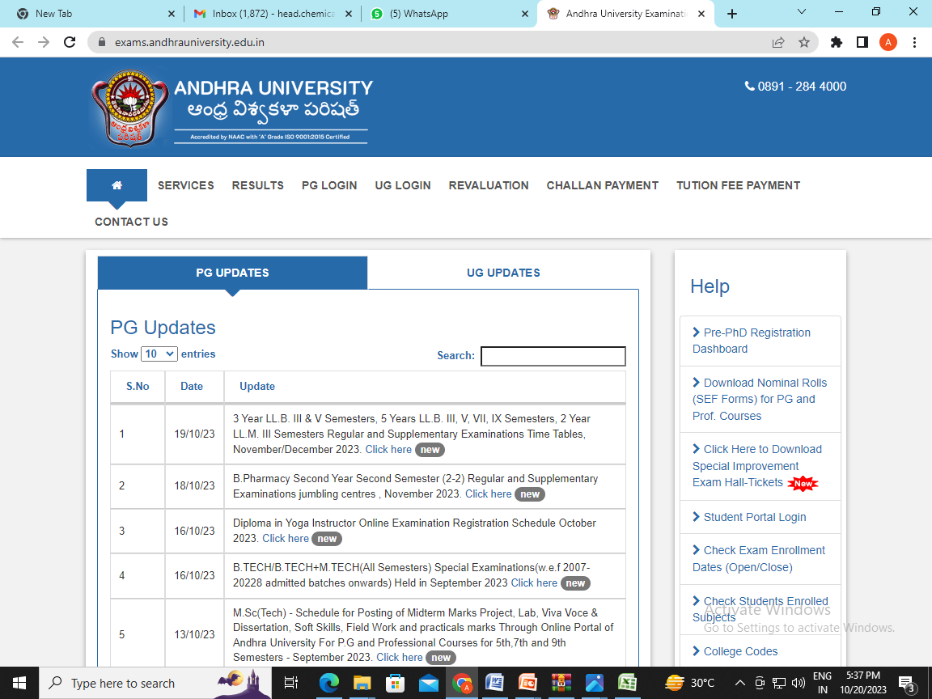
Evaluation process reforms (IT integration and automation) https://exams.andhrauniversity.edu.in/
Teaching, Learning and Evaluation (Contd..)
Andhra University has computerized examination management system.
Student has to enroll through online.
Personalized answer booklets/ barcoded OMR sheets are generated for each student.
Students can download web mark statement.
Revaluation is also applied through online.
Department of Chemical Engineering

Slide 48
Awards, Recognitions, Fellowships
Teaching, Learning and Evaluation (Contd.,)
Name of full time teachers receiving awards from state level, national level, international level | Year of Award | Designation | Name of the award, fellowship, received from Government or Government recognized bodies | Name of the Awarding Agency
Prof S.V. Naidu | 2017-18 | Professor | Best Teacher Award | Government of Andhra Pradesh
Prof. V. Sridevi | 2020 | Professor | Andhra Pradesh Scientist Award | AP State Council of Science and Technology
Dr. Ch. Asha Immanuel Raju | 2020-21 | Associate Professor | Education Icon Award 2020 | https://services.andhrauniversity.edu.in/filestorage1/iqacfiles/641ed317170c4.jpg
Dr. M.Tukaram Bai | 2021-22 | Assistant Professor | Global teacher award 2021 | https://services.andhrauniversity.edu.in/filestorage1/iqacfiles/641ed7b997f34.jpg
Awards , Recognitions, Fellowships -24
Department of Chemical Engineering

Slide 49
Criterion 3 Research, Innovations and Extensions
RESEARCH PROJECTS COMPLETED/ONGOING DURING LAST FIVE YEARS
Name of the scheme/Project/ Endowments/ Chairs | Name of the Principal Investigator/ Co Investigator (if applicable) | Name of the Funding agency | Type (Government/ Non- Government) | Year of Award | Funds provided (In Lakhs) | Duration of the project
Bioremediation technologies for treatment of phenol - strategies to enhance process efficiency | Prof.V.Sridevi | UGC, INDIA | Government | 2017 | 13.44 | 2015-18
UGC- Special Assistance Programmes(UGC-SAP-CAS-I) | Prof.G.M.J. Raju | UGC, New Delhi | Government | 2017 | 239.70 | 2016-21
Mitochondrial bioenergetics: substrate selection and utilization in normal and diabetic hearts-a theoretical study” | Dr.D.Santhosh Kumar | DST-SERB, DST, India | Government | 2019 | 35.31 | 2019-21
Department of Chemical Engineering

Slide 50
Criterion 3 Research, Innovations and Extensions
Revenue generated from consultancy during the last five years: Project Cost: INR 49.5L
AU Share: INR 5.56L
Name of the teacher consultant | Name of consultancy project | Consulting/Sponsoring agency with contact details | Year | Revenue generated (INR in Lakhs)
Prof. P.J.Rao | Performance of Evaluation of the MEE & RO Plant Sytems - stage-wise sample collection and preparation of report | M/s Krebs Biochemicals & Industries Ltd., Visakhapatnam | 2019-20 | 0.58
Prof. P.J. Rao | Groundwater Analysis & Soil Analysis | M/s HBL Power Systems Ltd., Vizianagaram. | 2020-21 | 0.20
Prof. P.J. Rao | Performance Evaluation of the MEE for RD Plant Systems stage-wise samples collection and Analysis. | M/s KREBS Biochemicals, Visakhapatnam Dist. | 2020-21 | 0.15
Prof. P.J. Rao | Conducting of Effluent Audit CETP | M/s Ramky Pharma City (India) Ltd., Visakhapatnam. | 2020-21 | 0.37
Prof. P.J. Rao | Study of Remediation, soil and ground water in and around factory | M/s HBL Power Systems Ltd., Pusapatirega, Vizianagaram Dist. | 2020-21 | 0.50
Prof. P.J. Rao | AU Study at Company Northern Boundary | M/s Smartchem Technologies Ltd.,Srikakulam | 2021-22 | 0.86
Prof. V. Sri Devi | Project on Impact of Primary & Secondary Pollutants on Crops around NTPC – Talcher, Odisha | NTPC, Talcher, Odisha | 2017-18 | 1.30
Prof. V. Sri Devi | Project on Impact of Primary & Secondary Pollutants on Crops around NTPC – Talcher, Odisha | NTPC, Talcher, Odisha | 2017-18 | 1.35
Prof. V. Sri Devi | Study on “Impact on Primary & Secondary Pollutants on Crops around NTPC – Talcher | NTPC, Talcher – Odisha | 2017-18 | 0.25
Department of Chemical Engineering

Slide 51
Criterion 3
Research, Innovations and Extensions
RESEARCH PUBLICATIONS DURING LAST FIVE YEARS :182
Best paper awards from professional societies/bodies
Name of the awards/Research/ innovation by exams/students/ scholars/student(Best poster/PPT/Member-awards) | Name of the Awardee | Name of the Awarding Agency with contact details | Year of Award | Category- institution/ teacher/ research scholar/student
Chemical Weekly Award for the best technical paper published in the Indian Chemical Engineer during 2021 | Prof.G.M.J.Raju Prof.K.V.Ramesh Prof.G.V.S.Sarma | Indian Institute of Chemical Engineers, Kolkata | 2020-21 | Teacher
Kuloor memorial award for best technical paper in Indian Chemical Engineer during 2021
IIChE NRC award for publication in Indian Chemical Engineer-Quarterly Journal of IIChE during 2021
Department of Chemical Engineering

Slide 52
Criterion 3
Research, Innovations and Extensions
ACHIEVEMENTS
S.No. | Category | 2017-18 | 2018-19 | 2019-20 | 2020-21 | 2021-22 | Total
1 | No. of Ph.Ds awarded | 12 | 09 | 16 | 10 | 6 | 53
2 | Patents awarded | - | - | 1 | 1 | 1 | 3
3 | Patents Published | - | 1 | 1 | 6 | 2 | 10
4 | Book Chapters | 2 | 5 | 5 | 3 | 11 | 26
5 | Awards from professional societies/bodies | 2 | 1 | - | 14 | 7 | 24
6 | FDPs attended | 2 | 5 | 13 | 10 | 3 | 33
7 | Conferences/Workshops attended | 4 | 4 | 24 | 1 | 5 | 38
8 | Conferences/Workshops Conducted | 4 | - | 2 | 1 | 2 | 9
9 | JRF/SRFs | 8 | 9 | 9 | 9 | 9 | 9
10 | GATE/ IELET students | 2 | 17 | 17/3 | 24 | 8/1 | 64
Department of Chemical Engineering

Slide 53
Criterion 3
Research, Innovations and Extensions
Patents Awarded: 3
Name of the Teacher | Patent Number | Title of the patent | Year of Award / publish of patent
Prof.V.Sridevi & Prof. M.V.V. Chandana Lakshmi | 6722/CHE/2015 / 318485 | Process for Phenol removal through Adsorption And Biodegradation | 2019 / 2016
Dr. Meena Vangalapati | 3825/CHE/2015 / 335672 | A Method for treating textile effluent | 2020 / 2015
Prof. Pulipati King, Prof. P. J. Rao | 202041011477 | Process to recovery valuable minerals from beach sand mineral processing plant waste and low grade phosphate, coal and iron ore waste deposits | 2022/2020
Department of Chemical Engineering

Slide 54
Criterion 3
Research, Innovations and Extensions
Patents Published:10
Name of the Teacher | Patent Number | Title of the patent | Year of Award / publish of patent
Dr.Ch.A.I. Raju | 201841025482 | Densification and Conversion of Green Biomass Waste and Municipal solid waste as Fuel Briquettes for Power Generation | - / 2018
Prof. S.V. Naidu | 201941019966 | Flow Field Design for Proton Exchange Membrane Fuel Cell | - / 2020
Dr.Ch.A.I. Raju Lt.Dr.N.M.Yugandhar | 202141016059 | A method for the production of L-ASPARAGINASE using Yarraowia Lipolytica, from a substrate pongamia oil cake (Ponggama pinnata) | - / 2021
Dr.Ch.A.I. Raju Lt.Dr.N.M.Yugandhar | 202141016060 | A method for the production of Bioethanol in solid state fermentation (SSF) using Saccharomyces cerevisiae, from the novel substrate of cantaloupe pulp | - / 2021
Dr.Ch.A.I. Raju Dr.M.Tukaram Bai | 202141033909 | A Method and composition for Biological Synthesis of Nanoparticles for degradation of textile dyes | - / 2021
Dr.M.Tukaram Bai Dr.Ch.A.I. Raju Dr.N. M.Yugandhar | 202141033914 | A Method for green power produced in MFC various microorganisms | - / 2021
Dr.M.Tukaram Bai Dr.Ch.A.I. Raju Dr.N. M.Yugandhar | 202141033918 | A Method of bacterial cultures to metallic nanoparticles with improved anti-microbial property | - / 2021
Dr.Ch.A.I. Raju Lt.Dr.N.M.Yugandhar | 202141033907 | A Method for Decolourization of dyes by using agricultural waste | - / 2021
Dr.Ch.A.I. Raju Dr.M.Tukaram Bai | 202241016808 | A Method of using hydrotopes in soap flotation for high recovery from low grade ores | - / 2022
Dr.Ch.A.I. Raju Dr.M.Tukaram Bai | 202241016805 | A Novel Method for batch grinding of laterite ore using statistical experimental design | - / 2022
Department of Chemical Engineering

Slide 55
Research, Innovations and Extensions
Criterion 3
Book chapters published: 26
Sl. No. | Name of the teacher | Title of the book/chapters published | Year of publication | Name of the publisher
1 | Prof.V.Sri Devi | Thermochemical and catalytic conversions for biorefineries | 2022 | Springer
2 | Prof.V.Meena | Removal of anionic surfactants by electrocoagulation process | 2022 | LAP Lambert
3 | Prof.V.Meena | Studies on Removal of Dicofol Pesticide | 2021 | LAP Lambert
4 | Dr Ch A I Raju | Fertilizer Technology for Chemical Engineers | 2022 | Schloars Press
5 | Dr Ch A I Raju | Nanotechnology for Chemical Engineers | 2022 | Schloars Press
6 | Dr Ch A I Raju | Ceramic Raw Materials | 2022 | Schloars Press
7 | Dr Ch A I Raju | Polymer Blends and Alloys | 2022 | Schloars Press
8 | Dr Ch A I Raju | Chemical Polymer Nano Composites | 2022 | Scholars Press
9 | Dr Ch A I Raju | Polymers in Fuel Cells | 2022 | Scholars Press
10 | Dr Ch A I Raju | Chemical Thermoplastic Elastomers | 2022 | Scholars Press
11 | Dr Ch A I Raju | Polymer for Energy Storage Applications | 2022 | Scholars Press
12 | Prof.GMJ Raju | Intelligent Computing in Control and Communication, Characterization of Yttrium-Doped NiAl Fabricated at Different Substrate Temperatures Using EBPVD for Bond Coat in Thermal Barrier Coatings | 2021 | Springer
Department of Chemical Engineering

Slide 56
Research, Innovations and Extensions
Criterion 3
Book chapters published
Sl. No. | Name of the teacher | Title of the book/chapters published | Year of publication | Name of the publisher
13 | Prof. R.Padma Sree | Lecture notes in Electrical Engineering | 2020 | Springer
14 | Dr. CH A I Raju | Energy Engineering for Chemical Engineers | 2020 | Scholars press
15 | Prof. K.V. Ramesh | Microelectronics, Electromagnetics and Telecommunications. Lecture Notes in Electrical Engineering | 2019 | Springer
16 | Dr. CH A I Raju | Environmental Studies for Chemical Engineers | 2019 | LAP Lambert Academic Publishing
17 | Dr. CH A I Raju | Fuels Refractories and Furnaces | 2019 | LAP Lambert Academic Publishing
18 | Dr. CH A I Raju | Bioinformatics for Biotechnology | 2019 | Scholars press
19 | Dr. CH A I Raju | Paper Technology for Chemical Engineers | 2019 | Scholars press
20 | Prof. Deepa Meghavathu | Emerging Trends In Engineering, Science And Technology For Society, Energy And Environment : Desalination studies on two single-sloped solar stills with heat-absorbing materials as coating material on aluminum basin | 2018 | Taylor and Francis
Department of Chemical Engineering

Slide 57
Research, Innovations and Extensions
Criterion 3
Book chapters published
Sl. No. | Name of the teacher | Title of the book/chapters published | Year of publication | Name of the publisher
21 | Dr. CH A I Raju | Computer Applications in Chemical Engineering | 2018 | LAP Lambert Academic Publishing
22 | Dr. CH A I Raju. | Solving chemical engineering problems using numerical methods in MATLAB code | 2018 | LAP Lambert Academic Publishing
23 | Dr. CH A I Raju | Computational methods in chemical engineering | 2018 | LAP Lambert Academic Publishing
24 | Dr. CH A I Raju | Computational Methods in MATLAB for Chemical Engineers | 2018 | LAP Lambert Academic Publishing
25 | Prof.S.V.Naidu | Materials, Energy and Environment Engineering, Springer, Singapore, Experimental studies on performance of single cell PEM fuel cell with various operating parameters | 2017 | Springer
26 | Prof.R. Padma Sree | Control of unstable Single and Multi-variable systems | 2017 | Alpha Science
Department of Chemical Engineering

Slide 58
Criterion 3
Research, Innovations and Extensions
JRF/SRFs:9
S.No. | Name of JRF/SRFs | Agency | Fellowship Amount per month (In INR) | Duration
1 | V. Suman | Rajiv Gandhi National Fellowship(RGNF-36104) | 40,000/– | 2017-2022
2 | A.Mahesh Kumar | Rajiv Gandhi National Fellowship (RGNF-32927) | 40,000/– | 2017-2022
3 | J. Anitha | Rajiv Gandhi National Fellowship (RGNF-35058) | 40,000/– | 2017-2022
4 | D. Vijaya Mitra | Rajiv Gandhi National Fellowship (RGNF-32895) | 40,000/– | 2017-2022
5 | S. Monica Nissy | Maulana Azad National Fellowship for Minority students (MANF-82897) | 40,000/– | 2017-2022
6 | K. Uday Kumar | Rajiv Gandhi National Fellowship (RGNF-29985) | 40,000/– | 2017-2022
7 | Ch. Ramya | National Fellowship for Other Backward Classes (NFOBC-73744) | 30,000/– | 2018-2023
8 | L. Neelima Chandra Lekha | National Fellowship for ST (NFST-00169) | 32,500/– | 2018-2023
9 | V. Sasi Kala | National Fellowship for ST (NFST-00977) | 32,500/– | 2018-2023
Department of Chemical Engineering

Slide 59
Criterion 3
Research, Innovations and Extensions (contd..)
FDPs attended: 33
S. No. | Name of the teacher | Title of the program
1 | Dr. CH A I Raju | Bioprocessing Strategies for Biofuels
2 | Prof. V.Sri Devi | AICTE Sponsored short term course” Thermo Waste Technology" : ATL
3 | Dr.P. Venkata Rao | Refresher course in computer science
4 | Dr.P. Venkata Rao | Short term course on computer applications
5 | Prof.R. Padma Sree | Capacity Building for Effective Environment Impact Assesment Appraisal"
6 | Prof.V.Sri Devi | AICTE Sponsored short term course” Thermo Waste Technology" : ATL
7 | Dr. M. Tukarambai | Nanofluidics: Theory, Computation and Applications,
8 | Dr. CH A I Raju | Short Term Course on Computer Applications for Teachers and Research Scholars
9 | Dr.G.V.S.Sharma | Advanced vibrationa analysis and its application in industry
10 | Dr. M. Tukarambai | Inter Disciplinary Refresher Course in Research Methodology for Sciences and Social Sciences
11 | Dr.P. Venkata Rao | Inter disciplinary course in research methodology for science & social sciences
12 | Dr. CH A I Raju | 2nd National Workshop on Bioprocessing Strategies for Biofuels by Sastra University
13 | Dr.G.V.S.Sharma | Interdisciplinary refresher course in environmental science
14 | Dr. M. Tukarambai | Inter Disciplinary Refresher Course in Environmental Sciences
15 | Prof. M.V.V.Ch.Lakshmi | International Education & Research
16 | Dr.P. Venkata Rao | Inter disciplinary course in environmental sciences
17 | Dr.P. Venkata Rao | Short term course on women studies
Department of Chemical Engineering

Slide 60
Criterion 3
Research, Innovations and Extensions (contd..)
FDPs attended
S. No. | Name of the teacher | Title of the program
18 | Lt.Dr.N.M.Yugandhar | Short term course on computer applications for teachers and research scholars
19 | Dr CH A I Raju | Inter Disciplinary Refresher Course in Research methodology for sciences and social sciences in AU UGC HRDC
20 | Dr.P. Venkata Rao | Capacity Building Workshop on “Outcome Based Education (OBE) and NBA Accreditation Process
21 | Lt.Dr.N.M.Yugandhar | Outcome based education and NBA Accreditation process
22 | Dr. M. Tukaram Bai | Capacity building workshop on "Outcome Based Education (OBE) and Accreditation Process"
23 | Dr.P. Venkata Rao | 01 Month Faculty Induction/ Orientation Programme (FIP)
24 | Prof.M.V.V.Ch.Lakshmi | Waste Technology :ATAL Training Program
25 | Lt.Dr.N.M.Yugandhar | Sustainable Engineering
26 | Lt.Dr.N.M.Yugandhar | Trends in Biotechnology
27 | Dr. M. Tukarambai | “Computational Fluid Flow and Heat Transfer (CFFHT)”
28 | Dr. M. Tukarambai | ATAL Training program, Biomedical Instrumentation.
29 | Lt.Dr.N.M.Yugandhar | Inter disciplinary refresher course in research methodology for science and social sciences
30 | Prof. M.V.V.Ch. Lakshmi | Inculcating Universal Human Values in Technical Education(5 day online FDP) (ATAL)
31 | Dr.Ch.A.I.Raju | Intellectual Property Rights in Academic: Criterion Protection and Commercialization (5 day online FDP) (ATAL)
32 | Dr.P. Venkata Rao | Inculcating Universal Human Values in Technical Education(5 day online FDP) (AICTE)
Department of Chemical Engineering

Slide 61
INDUSTRY-INSTITUTE-INTERACTION & COLLABORATIONS
MoUs:
Memorandum of Understanding between Hindustan Petroleum Corporation Limited, Visakh Refinery, Visakhapatnam and Andhra University, Visakhapatnam for Establishment of Process Modeling & Simulation Laboratory at Andhra University, Visakhapatnam. CSR Grant is received for development of Simulation Lab at Chemical Engineering Department-MOU Copy (INR 16.5L)
Memorandum of Understanding between Indian oil Corporation Limited (IOCL), Mumbai acting through its R&D centre, Faridabad and Andhra University, Visakhapatnam to Collaborate for the promotion of education, research and innovation under which CSIR/UGC-NET/GATE qualified students will be given an opportunity to pursue Ph.D. under joint supervision of AU and IOCL on topic of mutual interest.- MoU Copy
Deccan Fine Chemicals, Visakhapatnam Steel Plant-RINL, IICT, Hyderabad, Dr. Reddy’s Laboratories, Aurobindo Pharma, NFCL, Coromandel International Ltd, BHEL, Visakhapatnam, ONGC,HPCL, Visakha Dairy, Naval Science & Tech. Laboratory – DRDO, Ramky Pharma, Nuclear Fuel Complex, Hyderabad, Andhra Pradesh Medtech Zone, Visakhapatnam-320 Students
Department of Chemical Engineering

Slide 62
Infrastructure and Teaching Resources
Criterion 4
S. No. | Room number and Name of classrooms | Type of ICT facility
1 | Main Block Lecture Hall -2– E & Smart Class Room | AC, LCD, White Screen,Digital Interactive Smart Board, Electronic Podium,Wi-Fi
2 | Main Block Lecture Hall -3– E & Smart Class Room | AC, LCD, White Screen, Digital Interactive Smart Board, Electronic Podium,Wi-Fi
3 | Main Block Lecture Hall -4– E & Smart Class Room | AC, LCD, Digital Interactive Smart Board, Electronic Podium, Wi-Fi
4 | Main Block Lecture Hall -5– E & Smart Class Room | AC, LCD, White Screen, Digital Interactive Smart Board, Electronic Podium, Wi-Fi
5 | Main Block Lecture Hall -1–Class Room | AC, LCD, White Screen, Electronic Podium, Wi-Fi
6 | Main Block Lecture Hall -6–Class Room | AC, Wi-Fi
7 | Main Block Lecture Hall -7–Class Room | AC, Wi-Fi
8 | Main Block Lecture Hall -8–Class Room | AC, Wi-Fi
9 | Seminar Hall | AC, LCD, White Screen, Digital Board, Electronic Podium, Wi-Fi
10 | Drawing Hall | 90 drawing tables, W-iFi
11 | PG Building Lecture Hall -1–Class Room | Wi-Fi
12 | PG Building Lecture Hall -2–Class Room | Wi-Fi
13 | PG Building Lecture Hall -3–Class Room | Wi-Fi
14 | PG Building Lecture Hall -4–Class Room | Wi-Fi
15 | Computer Lab | AC, LCD, White Screen, Wi-Fi, 30+15 Computers, Licensed Software (MATLAB, Aspen plus, ANSYS, Origin), LAN Facility

Slide 63
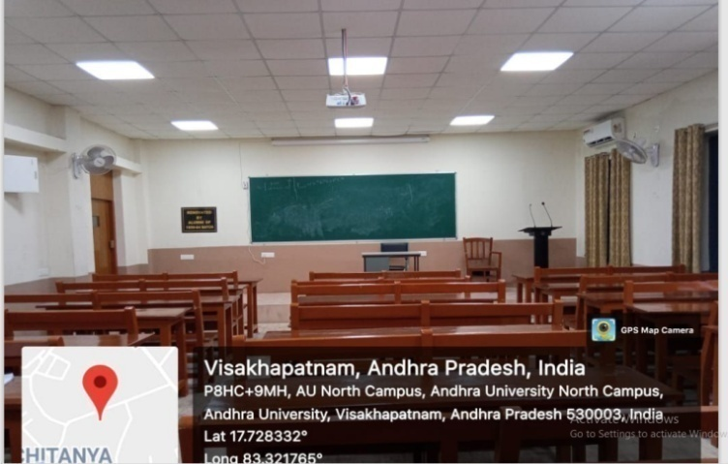
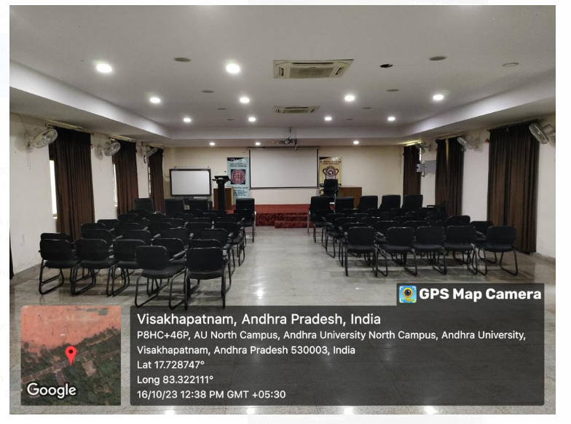
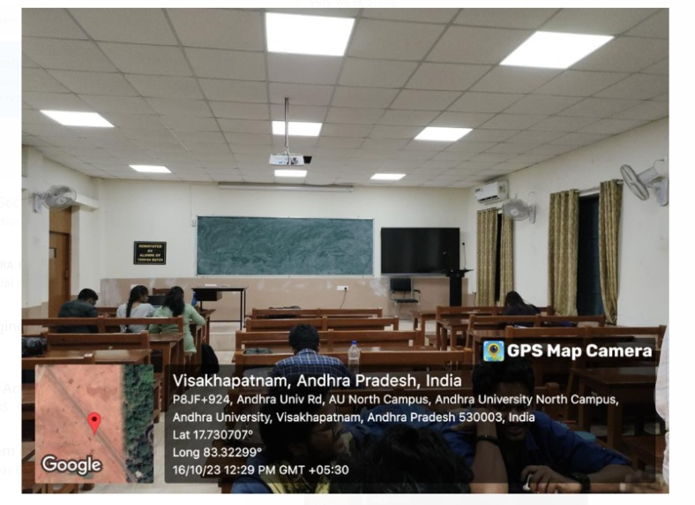
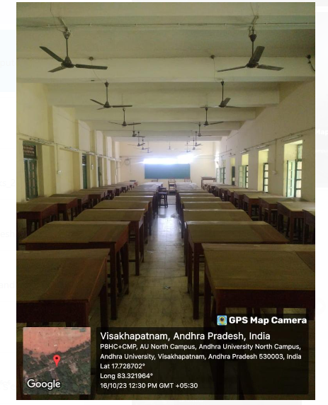
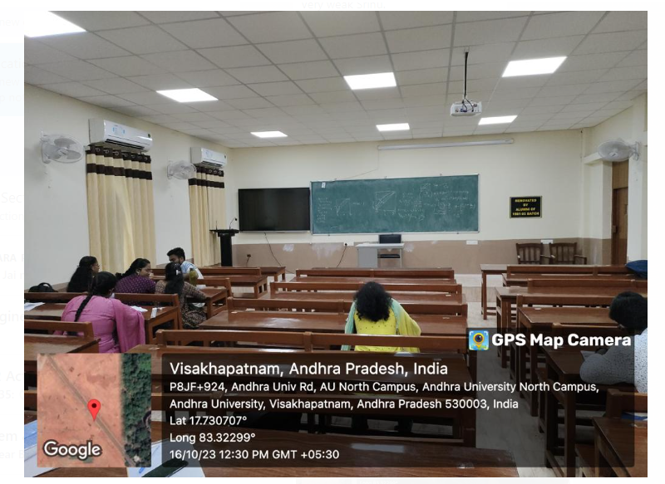
Criterion 4 Infrastructure and teaching resources
o e-Class rooms / smart class rooms
Main Block – LH-1 (Alumni Funded)
Main Block – Seminar hall (Alumni Funded)
Main Block – LH-3 (Alumni Funded)
Main Block – Drawing hall (Alumni Funded)
Main Block – LH-5 (Alumni Funded)
Main Block – LH-2 (Alumni Funded)
* The Department is totally technology enabled. There is 24/7 internet and Wi-Fi connection available for the staff and students. There are Nine LCD projectors (including 1 portable), 4 Digital interactive smart Boards, one laptop, audio-visual equipment to have online class as well as offline classes.
Department of Chemical Engineering

Slide 64
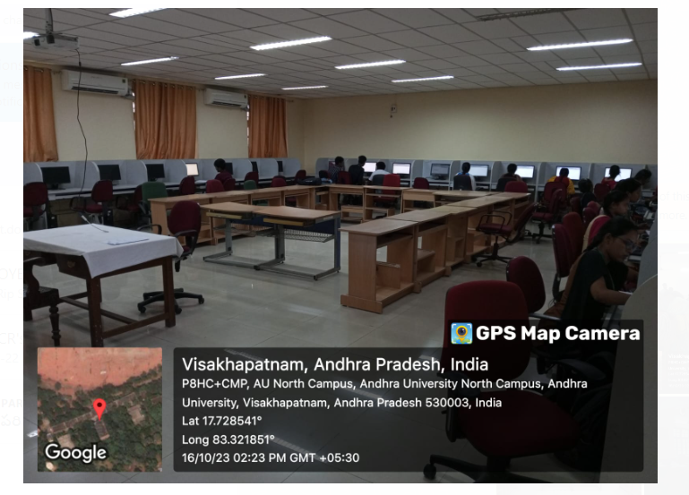
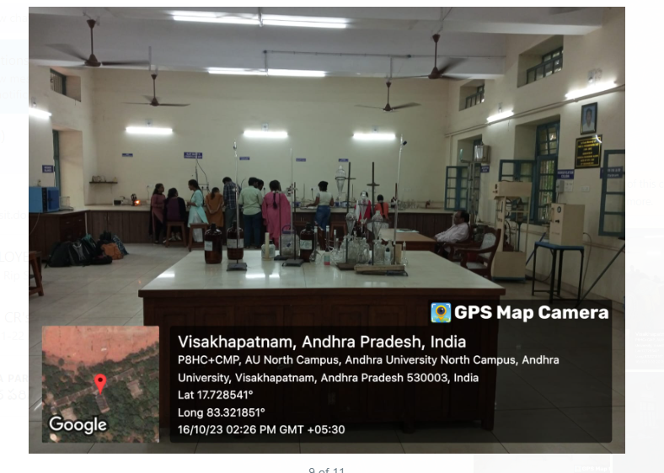
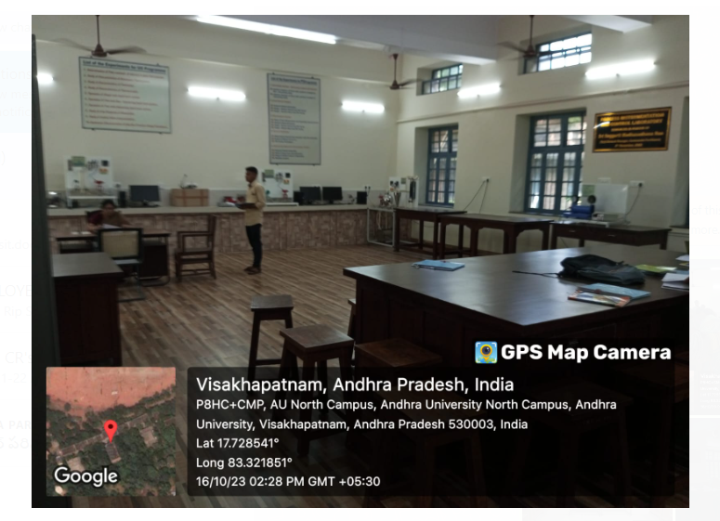
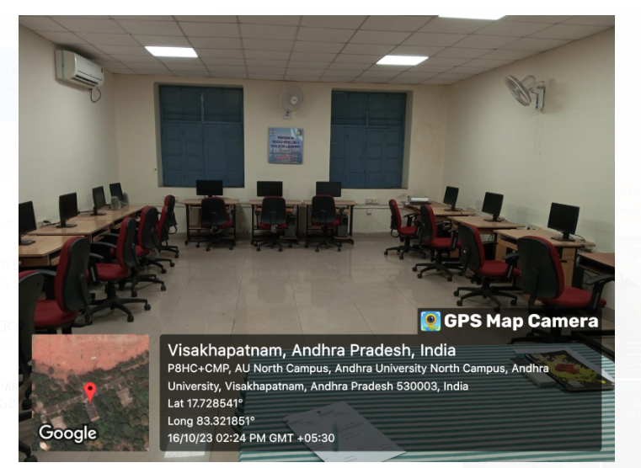
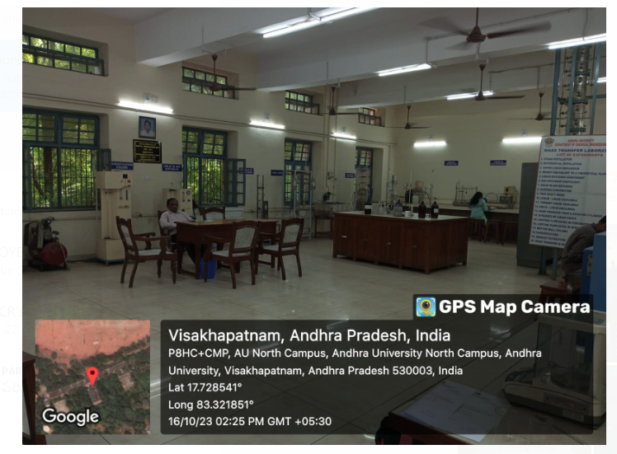
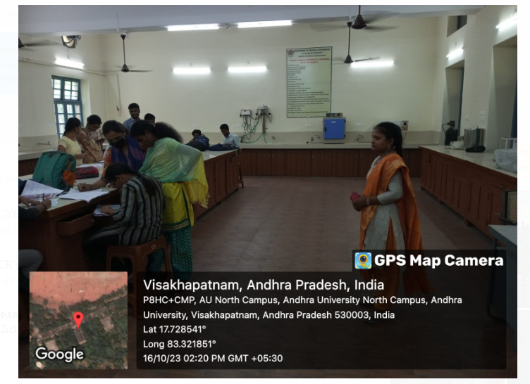
Criterion 4 Infrastructure and teaching resources
Computer Lab
(Alumni Funded-30 Computers)
Mass Transfer Lab (Alumni Funded)
Process Instrumentation and control Lab
(Alumni Funded)
Process Modeling and Simulation Lab
(HPCL, CSR Funds-15 Computers)
Mass Transfer Lab (Alumni Funded)
General Chemical Technology Lab
(Alumni Funded)
Department of Chemical Engineering

Slide 65
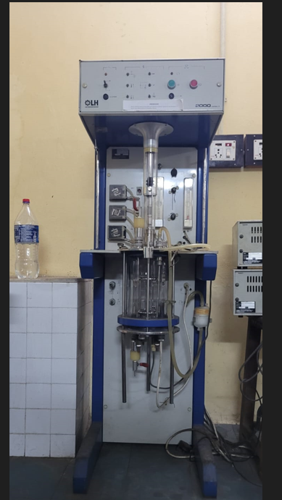
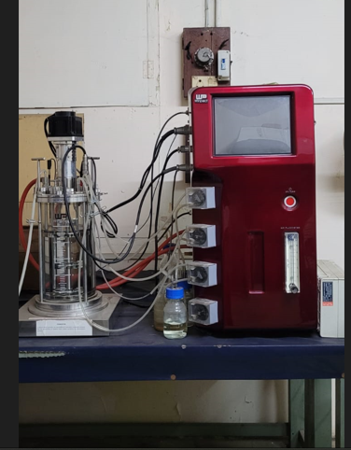
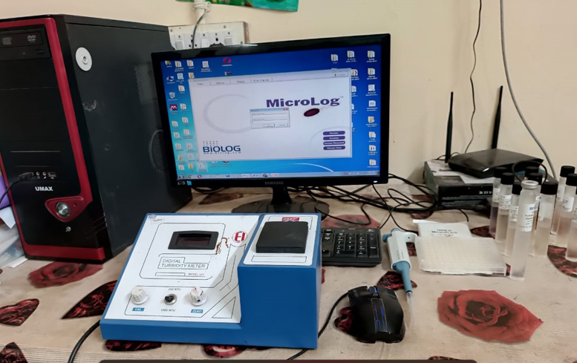
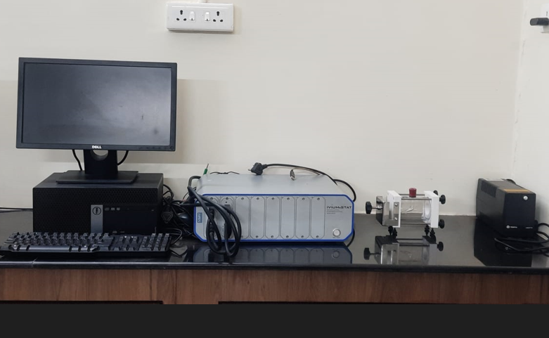
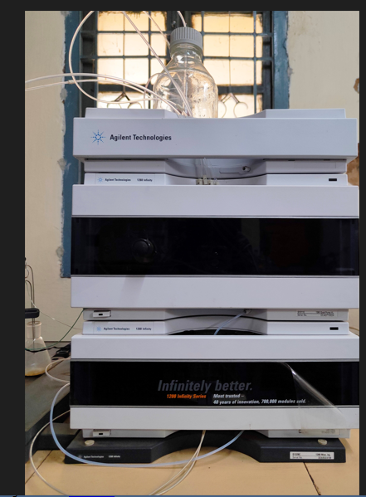
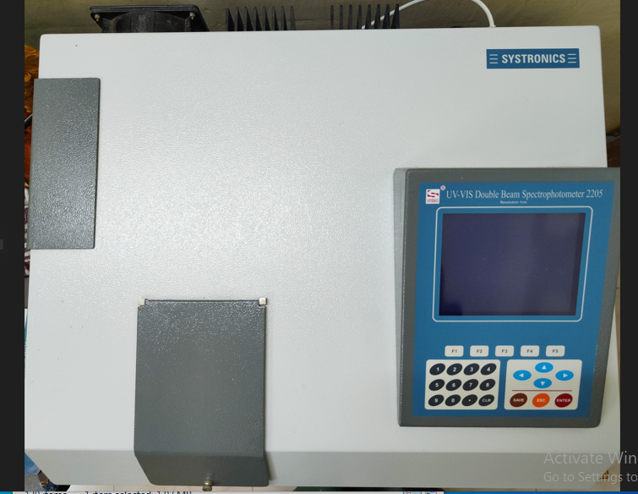
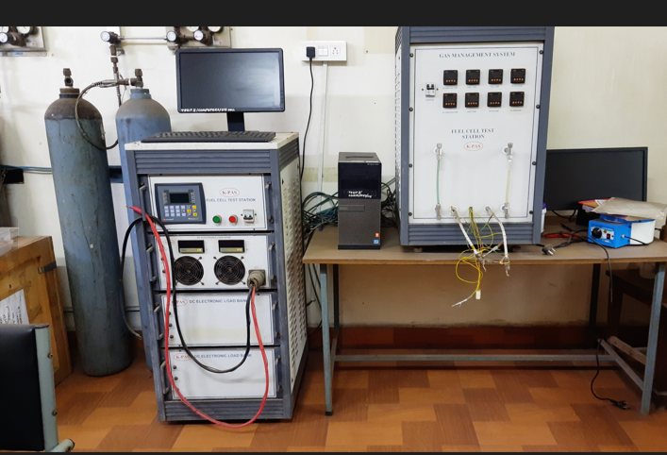
Infrastructure and teaching resources:
List of costly equipment
Fermentor 1
Fermentor 2
Gen III Micro log System
Electro Chemical Work Station
HPLC System
UV Spectrophotometer
PEM Fuel Cell Station
Department of Chemical Engineering

Slide 66
Criterion 4 Infrastructures and teaching resource
Department library/e -resources/Wi-fi/internet facilities / Bandwidth / link to library e resources
College is having 1GBPS leased line.
IEEE and DELNET, Central Funding (E-SHODHSINDHU, SHODHGANGA), J-GATE, INFILIBNET
https://www.andhrauniversity.edu.in/library
E-Journals – IEEE, ASME etc.
Apex Journals
DELNET - http://delnet.in/
J-Gate : Database
INFLIBNET : 265 (Chemical Engineering Journals)
Web of Science : Database
MathSciNet : Database
Department of Chemical Engineering

Slide 67
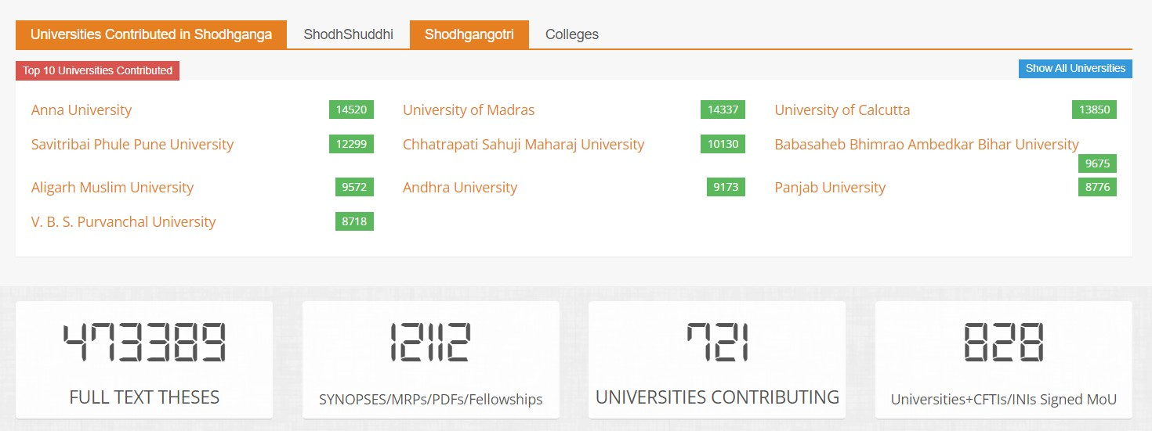
Infrastructure and teaching resource
Criteria 4
Link to library e resources (Contd..)
SHODHGANGA - https://shodhganga.inflibnet.ac.in/
Andhra University in Top 10 Indian Universities in Shodhganga.
Andhra University
9173 Theses
Department of Chemical Engineering

Slide 68
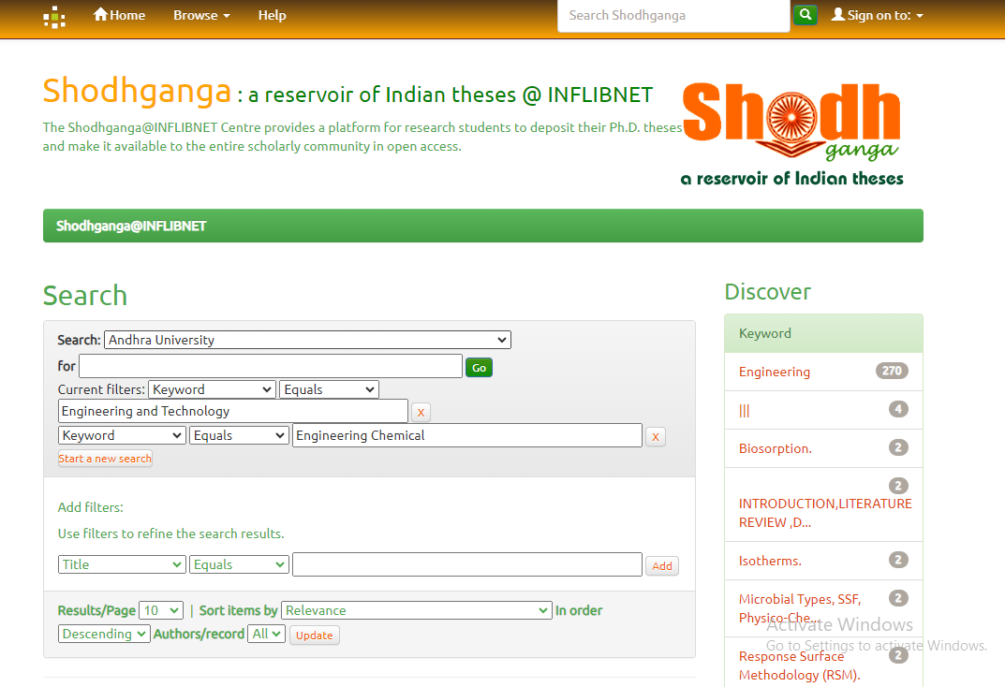
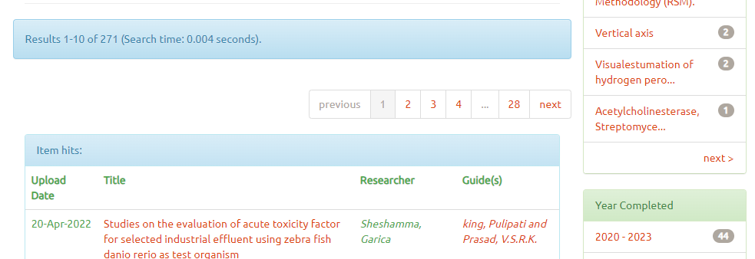
Infrastructure and teaching resource
Criteria 4
Link to library e resources (Contin..) SHODHGANGA – Chemical Engineering – 271 Theses

Slide 69
Students Support and Progression
Criterion 5
Placements & Higher Studies

Slide 70
Criterion 5
Placements
Students Support and Progression
No. of Students Placed
Year (Passed out)
Department of Chemical Engineering

Slide 71
Criterion 5
Students Support and Progression
Higher Studies
Student Activities
No. of Students
Year (Passed out)
87th -90th Convocation
Department of Chemical Engineering

Slide 72
Criterion 5
Students Support and Progression
Student Activities-Department Day Celebrations
Department of Chemical Engineering

Slide 73
Students Support and Progression
Criterion 5
Ind
ependence Day
Republic Day
Blood Donation
International Yoga Day
Student Activities
Tri Color Flag
Day
S
watch Bharath
NSS –Chemical
Salute to our Pulwama Martyrs
Community Service
Anti-ragging awareness rally
Department of Chemical Engineering

Slide 74
Prominent Alumni
Criterion 5
Prof. C. Venkata Rao, Founder, Dept. of Chemical Engineering, A. U.
Prof. C. Chiranjeevi, Best Academician
Prof. G. J. V. J. Raju, First Rector of AU, Former Chairman of APSCHE, NBA & AICTE, Former Vice- Chancellor, Acharya Nagarjuna University
Sri Bolla Bulli Ramayya, Former Central Minister of India
Sri Y.V.S.Murthy, Industrialist & Scientist
Sri T Purnachandra Rao, Energy Consultant, Dallas, Texas, USA
Sri S. Poorna Chandra Rao, Vice Chairman, Bank of America, USA
Mrs.D.Sandhya, Vice President and Managing Director, Meta, India
Prof. G.Pandu Rangaiah, National University of Singapore &Visiting
Professor, AU
Sri D.V.S.Narayana Raju, Chairman, Deccan Fine Chemicals
Sri K.Murali, Former Executive Director, HPCL
Prof.V.S.R.K.Prasad, Founder Director, IIPE, Visakhapatnam
Dr.V.V.N.Kishore, Former Visiting Professor, IIT-Bombay
Department of Chemical Engineering

Slide 75
Prominent Alumni
Criterion 5
Sri M.Ganapathi, Former President, Reliance Industries Limited
Sri S.V.Praveen, Former Director, LG Polymers
Dr.V.N.Rao, Former Vice President, Andhra petrochemicals
Sri N.Seeta Ram, Former Director, Coromandel International
Sri Habibulla, Former General Manger, L & T
Dr.D.M.R.Sekhar, Mineral Process Engineering Consultant, Jordan
Sri D.M.R.Sekhar, Former Executive Director, ONGC, Rajahmundry
Sri G.V.S.V.S.S.S.Prasad Sarma, Former Executive Director, HPCL, Visakhapatnam
Sri G.Madhu Kumar, Secretary & Correspondent, Dr. L. Bullaya Colleges
Sri M.H.Avadhani, Former CMD., IFFCO
Sri R.V.Subba Rao, Former Director, CECRI, Karaikudi
Prof. M.N.Rao, Former Director, IIT Kharagpur
Sri K.Ramabhramam, Former Chairman, Dutsons Builders & Estates Pvt. Ltd.
Sri V.Appala Raju, Former Additional Commissioner of Income Tax
Sri Jaideep Poondir, Former Senior Vice President, Cognizant
Sri P.S.Murthy, Industrialist
Sri V.Ratan Raju, Executive Director HPCL
Department of Chemical Engineering

Slide 76
Alumni contributions : INR 221.36 L
Name of the Alumni | Batch | Amount (Rs. in lakhs)
Sri Talluri Purnachandra Rao (Furniture, Drawing hall, Computer lab, etc.) | 1968-73 | 35.16
Sri Saggurti Purnachandra Rao(GCT Lab & PIC Lab) | 1975-80 | 36.00
Alumni (Mass Transfer Lab) | 1975-80 | 19.70
Alumni (Lecture Hall-2) | 1959-64 | 12.00
Alumni (Lecture Hall-5) | 1981-85 | 9.26
Sri Jaideep Poondir (Corpus Fund-1 lakh per annum since 2014) | 1983-87 | 10.00
Alumni (Lecture Hall-3) | 1961-66 | 8.73
Alumni (Lecture Hall-1) | 1985-89 | 8.16
Alumni (Corpus) | 1983-87 | 8.00
Alumni (Seminar Hall) | 1966-71 | 8.00
Alumni (Lecture Hall-6) | 1959-64 | 7.00
Dr. Veeranna Doddipatla (Somidevarapalem People’s Welfare Trust) Dept. Library Furniture | 1968-73 | 5.81
Alumni (PG Building Wash Rooms) | 1993-97 | 4.95
Dr. Roja Rao Challa (FM, MO, HT, Prof.GMJ Raju Research lab slab) | 1968-73 | 4.60
Dr. Murali Krishna Maddi (FM, MO, HT, Prof.GMJ Raju Research lab slab) | 1968-73 | 3.62
Sri Sirish Chandra Dandamudi & Raghuram Putcha (FM, MO, HT, Prof.GMJ Raju Research lab slab) | 1985-89 | 3.30
Dr. P. Lakshmi Manga (Dr. P.S. Murti Memorial Award) | - | 3.00
Prof. G.M.J Raju (Electrochemical Engg Lab Renovation) | 1985-89 | 5.00
Alumni (Drawing Hall) | 1982-86 | 3.00
Sri Ravi Kumar Talluri (Sri T. Ramaiah Memorial Scholarship) | - | 2.97

Slide 77
Alumni contributions
Name of the Alumni | Batch | Amount (Rs. in lakhs)
Alumni (Electrical Engineering Lab Slab) | 1968-73 | 2.55
Sri. K. Gopala Rao (K. Kameswara Rao Memorial Scholarship) | 1946-51 | 2.00
Sri.G. Prabhakar Rao (Workshop and Labs slab) | 1968-73 | 2.00
Alumni (Gents Wash Rooms) | 1992-96 | 1.30
Prof. R.N. Sinha and Dr. P.V. Ravi Kumar (Prof. Chelikani Chiranjeevi Scholarship) | 1962-67 & 1982-86 | 1.25
Prof.G.P. Rangaiah (Workshop slab) | 1968-73 | 1.00
Prof. V. Sujatha (First Woman Head of the Department) | 1973-78 | 1.00
Smt. M. Bharathi Rao (First Girl Student of the Department) | 1968-73 | 1.00
Dr. D.M.R. Sekhar (Sri P.V. Reddy and Sri P. Manmadha Rao Scholarship) | 1970-75 | 1.00
Sri. E. Pardhasaradhi (Sri E. Venkateswarulu Award) | 1969-74 | 1.00
Prof. V. S. R. K. Prasad (Workshop slab) | 1969-74 | 1.00
Prof. D.Subba Rao (Workshop slab) | 1969-74 | 1.00
Sri. M.Raghavaiah (Workshop slab) | 1969-74 | 1.00
Prof. D. V. S. Murthy (Sri D.V. Krishnaiah Memorial Scholarship) | - | 1.00
Sri .Alla Ramachandra Rao (Workshop slab) | 1968-73 | 1.00
Sri .A.L.N. Murthy (Workshop slab) | 1968-73 | 1.00
Sri .K. Sreedhar (Workshop slab) | 1968-73 | 1.00
Prof. S. V. Naidu (Sri S.R.K. Murthy Memorial Scholarship) | 1981-85 | 1.00
Sri. Suryadevara Jogendra (Scholarship) | 1975-80 | 1.00

Slide 78
Criterion 6
Governance, Leadership/Management
Faculty provided with financial support to attend conferences / workshops: 9
Year | Name of teacher | Name of conference/ workshop attended for which financial support provided | Name of the professional body for which membership fee is provided | Amount of support(in INR)
2017-18 | Prof. D. Appala Naidu | Workshop For Faculty Mentors On Induction Program For New Students | NPIU,MHRD | 26,825/-
2017-18 | Prof. V Sri Devi | National Workshop On " Strategies For Prevention And Control Of Industrial Pollution" | Andhra University | 35,000/-
2017-18 | Prof. D. Sri Rami Reddy | Twinning Programme Of TEQIP III Activity | Andhra University | 32,641/-
2018-19 | Prof. G.V.S. Sarma | 9th International Conference On "Material Processing And Characterization" (ICMPC-2019) | GRIET, Hyderabad | 14,372/-
2018-19 | Dr. M.Tukaram Bai | 9th International Conference On Material Processing And Characterization (ICMPC-2019) | Gokaraju Rangaraju Institute of Engineering and Technology, Hyderabad | 12,848/-
2019-20 | Prof.V.Meena | 106th Indian Science Congress (ISC - 2019) | Lovely Professional University, Jalandhar | 46,745/-
2019-20 | Prof. G.V.S. Sarma | First International Conference on Recent Advances In Materials and Manufacturing (ICRAMM-2019) | Belgavi, Karnataka | 19,493/-
2020-21 | Prof. D. Appala Naidu Prof. M.V.V.Ch. Lakshmi | Two Days National Level Webinar On "Trends In Biotechnology" | Andhra University | 20,000/-
2021-22 | Prof. G.M.J. Raju | International Webinar On "Recycling Solid Waste Management" | Andhra University | 20,000/-
Department of Chemical Engineering

Slide 79
Criterion 6
Governance, Leadership/Management
Financial support by various agencies for advanced studies/research
year-wise during the last five years:18
S.No. | Name of the teacher awarded national/ international fellowship/financial support | Name of the award/fellowship | Year of the Award | Awarding Agency
1 | Prof.V.Sridevi | Extramural Research award | 2017-2018 | UGC, INDIA
2 | Prof. D. Appala Naidu | workshop for faculty mentors on induction program for new students held at New Delhi | 2017-2018 | TEQIP - PHASE 3, MHRD
3 | Dr. M. Tukaram Bai | International Conference on Emerging Trends in Engineering Science and Technology held at Government Engineering College Trichur (GECT) | 2017-2018 | TEQIP - PHASE 3, MHRD
4 | Dr. M. Tukaram Bai | 5th Beinnial International Conference on Emerging trends inEngineering Science and Technoogy, Thrissur held at Kerala | 2017-2018 | TEQIP - PHASE 3, MHRD
5 | Prof. M V V Chandana Lakshmi | A two day national workshop on " Advanced technologies for Biomolecule Separations: ATBMS-2018" | 2017-2018 | TEQIP - PHASE 3, MHRD
6 | Dr. N M Yugandhar | International conference on " Environmental Biotechnology and Biodivesity-2017" | 2017-2018 | TEQIP - PHASE 3, MHRD
7 | Dr.D.Santhosh Kumar | Extramural Research award | 2018-2019 | DST, India
8 | Dr. D.Santhosh Kumar | Extramural Research award | 2018-2019 | UGC, INDIA
9 | Dr. D.Santhosh Kumar | Start-up Research Grant | 2018-2019 | UGC, INDIA
10 | Prof.V.Meena | 106th Indian Science Congress (ISC- 2019) held at Lovely Professional University, Jalandhar,Punjab | 2018-2019 | TEQIP - PHASE 3, MHRD
Department of Chemical Engineering

Slide 80
Criterion 6
Governance, Leadership/Management
Financial support by various agencies for advanced studies/research year-wise during the last five years
S.No. | Name of the teacher awarded national/ international fellowship/financial support | Name of the award/fellowship | Year of the Award | Awarding Agency
11 | Dr.M.Tukaram Bai | 9th International Conference on Material Processing and Characterization (ICMPC-2019) held at Gokaraju Rangaraju Institute of Engineering and Technology, Hyderabad | 2018-2019 | TEQIP - PHASE 3, MHRD
12 | Dr.D.Santhosh Kumar | Extramural Research award | 2019-2020 | DST, India
13 | Dr. D.Santhosh Kumar | Extramural Research award | 2019-2020 | UGC, INDIA
14 | Dr. G.V.S. Sarma | International seminar and presenting paper in the International Conference on "Material Processing and Characterisation" held at GRIET, Hyderabad | 2019-2020 | TEQIP - PHASE 3, MHRD
15 | Dr. G V S sarma | International Conference on Advances in Materials and Manufacturing, ICRAMM at Karnataka | 2019-2020 | TEQIP - PHASE 3, MHRD
16 | Dr. M Tukaram Bai | First International Conference on Recent Advances in Materials and Manufacturing, Belagavi at Karnataka | 2019-2020 | TEQIP - PHASE 3, MHRD
17 | Dr.D.Santhosh Kumar | Extramural Research award | 2020-2021 | DST, India
18 | Dr. D.Santhosh Kumar | Extramural Research award | 2020-2021 | UGC, INDIA
Department of Chemical Engineering

Slide 81
Criterion 6
Governance, Leadership/Management (contd.,)
FDPs attended: 33
S. No. | Name of the teacher | Title of the program
1 | Dr CH A I Raju | Bioprocessing Strategies for Biofuels
2 | Prof. V.Sridevi | AICTE Sponsored short term course” Thermo Waste Technology" : ATL
3 | Dr.P. Venkata Rao | Refresher course in computer science
4 | Dr.P. Venkata Rao | Short term course on computer applications
5 | Prof.R. Padma Sree | Capacity Building for Effective Environment Impact Assessment Appraisal"
6 | Prof.V. Sridevi | AICTE Sponsored short term course” Thermo Waste Technology" : ATL
7 | Dr. M. Tukarambai | Nanofluidics: Theory, Computation and Applications,
8 | Dr CH A I Raju | Short Term Course on Computer Applications for Teachers and Research Scholars
9 | Dr.G.V.S.Sharma | Advanced vibrationa analysis and its application in industry
10 | Dr. M. Tukarambai | Inter Disciplinary Refresher Course in Research Methodology for Sciences and Social Sciences
11 | Dr.P. Venkata Rao | Inter disciplinary course in research methodology for science & social sciences
12 | Dr CH A I Raju | 2nd National Workshop on Bioprocessing Strategies for Biofuels by Sastra University
13 | Dr.G.V.S.Sharma | Interdisciplinary refresher course in environmental science
14 | Dr. M. Tukarambai | Inter Disciplinary Refresher Course in Environmental Sciences,
15 | Prof. M.V.V.Ch.Lakshmi | International Education & Research
16 | Dr.P. Venkata Rao | Inter disciplinary course in environmental sciences
17 | Dr.P. Venkata Rao | Short term course on women studies
Department of Chemical Engineering

Slide 82
Criterion 6
Governance, Leadership/Management (contd.,)
FDPs attended
S. No. | Name of the teacher | Title of the program
18 | Lt.Dr.N.M.Yugandhar | Short term course on computer applications for teachers and research scholars
19 | Dr CH A I Raju | Inter Disciplinary Refresher Course in Research methodology for sciences and social sciences in AU UGC HRDC
20 | Dr.P. Venkata Rao | Capacity Building Workshop on “Outcome Based Education (OBE) and NBA Accreditation Process
21 | Lt.Dr.N.M.Yugandhar | Outcome based education and NBA Accreditation process
22 | Dr. M. Tukaram Bai | Capacity building workshop on "Outcome Based Education (OBE) and Accreditation Process"
23 | Dr.P. Venkata Rao | 01 Month Faculty Induction/ Orientation Programme (FIP)
24 | Prof.M.V.V.Ch.Lakshmi | Waste Technology :ATAL Training Program
25 | Lt.Dr.N.M.Yugandhar | Sustainable Engineering
26 | Lt.Dr.N.M.Yugandhar | Trends in Biotechnology
27 | Dr. M. Tukarambai | “Computational Fluid Flow and Heat Transfer (CFFHT)”
28 | Dr. M. Tukarambai | ATAL Training program, Biomedical Instrumentation.
29 | Lt.Dr.N.M.Yugandhar | Inter disciplinary refresher course in research methodology for science and social sciences
30 | Prof. M.V.V.Ch. Lakshmi | Inculcating Universal Human Values in Technical Education(5 day online FDP) (ATAL)
31 | Dr.Ch.A.I.Raju | Intellectual Property Rights in Academic: Criterion Protection and Commercialization (5 day online FDP) (ATAL)
32 | Dr.P. Venkata Rao | Inculcating Universal Human Values in Technical Education(5 day online FDP) (AICTE)
Department of Chemical Engineering

Slide 83
Criterion 6
Governance, Leadership/Management (contd.,)
Guest Lectures:25
Name of the Alumnus | Topic | Date
Dr.Abhay K.Mahantha Scientist-E,NSTL | Fire & Industrial Safety Highlighting the Science of Fire, Static, Electricity Batteries and Explosive Safety | 10-08-2017
Dr.R.Bhima Rao FIE,Former Chief Scientist,CSIR-IMMT, GOI | Applications of Micro wave Energy in food Processing to minerals, metallurgical and materials processing | 12-09-2017
Prof. M.Chidambaram Retd. Professor Department of Chemical Engg, IIT Madras | Modeling and Simulation for Chemical Engineers | 18-09-2017
 | Optimization Techniques | 19-09-2017
 | Methods of tuning PID controls | 20-09-2017
 | Discrimination of mathematical models | 21-09-2017
S.S.V. Rama Kumar, Director R&D, IOCL, R&D Centre, Faridabad. | Indian energy scenario- trends and game changers. | 28-10-2017
Dr.Srinivas Konduri Section Head,Process Engineering Maaden Phosphat Company, Saudi Arabia | A powerful tool in improving process performance-A case study | 01-11-2017
Padmavibhushan Prof.M.M.Sharma | Milestones in Chemical Industry | 18-12-2017
Prof. D.P.Rao, Retd. IIT Delhi | The boundary condition and method of solution Zwittering’s, maximum mixedness reactor model. | 23-10-2018
Ms. Priyanka Nimmani, IIT Gandhinagar | Finite deformation constitutive theory of polymer gels. | 21-01-2019
Prof. M.Chidambaram Retd. Professor, Dept of Chemical Engg, IIT Madras and Emeritus Professor, NIT Waeangal | Mathematical Modeling and Simulation | 21-11-2019
 | Trends in Engineering Education | 22-11-2019
Department of Chemical Engineering

Slide 84
Criterion 6
Governance, Leadership/Management (contd.,)
Guest Lectures
Name of the Alumnus | Topic | Date
Sri D.V.S. Narayana Raju Executive Director, Deccan Fine Chemicals (India) Pvt. Ltd. | Interaction with 3rd year and 4th year students | 17-02-2020
Prof.G.Pandurangaiah of National University of Singapore | Industry 4.0 | 13-10-2022
Sri Shankar Tadepalli of Span Industrial/ Span Control Systems Pvt. Ltd, Hyderabad | Automation in Process Industry | 07-02-2023
Dr. Krishna M. Pamidimukkala, New Jersey, USA | Photovoltaic System Design and Installation | 14-02-2023
Sri K.Gangu Naidu, Associate Fire Protection Engineer, JGC India EPC Privite Limited | Process Safety Aspects in EPC Projects | 17-02-2023
Sri Venkata Ramana Murthy Bommireddipalli | Refining Technology Crude Oil Introduction/ Refinery Products/ Atm. Distillation | 24-02-2023
Sri G.Sanjeeva Reddy | Environment-Industrial Practices-Exploration & Production-Oil company | 10-03-2023
Sri Dharma Rao Namballa | Vision-Mission: Career Growth/ Development in Global Corporate Secctor-HR Perspective | 24-03-2023
Mrs K.V. Uma Devi, Director Career Counselling & Mentoring, GITAM Career Guidance Center (GCGC), GITAM | Preparation for Careers | 28-07-2023
Dr. Ch. V.G.K. Murthy, Sr. Vice President & Business Head, Adani Enterprises | Beneficiation of different ores- Role of a Chemical Engineer | 10-08-2023
Sri K. V. Siva Prasad (Retired DGM, RINL, Visakhapatnam) | Steel Making at Visakhapatnam Steel Plant | 15-09-2023
Mr. Lakshmi Narayana K, Decarbonization Master planning Advisor, Shell group of Companies at USA | Energy Transition and Chemical Engineering | 13-10- 2023
Department of Chemical Engineering

Slide 85
Criterion 7
Best Practices
Department Alumni association supports for organizing personality development classes for final year students by outside agencies. Department organizes guest-lectures by the Alumni (Industry, R&D) to motivate students.
Merit and Economically deserving student Scholarships: The Department has been supporting the students by giving merit scholarships for the toppers of 1st, 2nd and 3rd year students of B.Tech. Chemical Engineering and Biotechnology, Course wise toppers for some courses, GATE toppers in the department, progressively performing students (Academically) and economically backward students.
Incubation and Innovation: Department is encouraging students to participate in start ups in multidisciplinary Incubation Hub (a-hub) - skill development centers (Govt. of India). Students are encouraged to participate in Hackathon’s and Ideathon’s.
‘Yoga for professionals’ course is included in the curriculum for holistic development.
Department of Chemical Engineering

Slide 86
Criterion 7
Best Practices Cond..
EDUMOON: An Ed-Tech Startup working on the Development Of the Student Community by providing Up-skilling Courses, Webinars, Workshops, and Internships to Students through our Student Community of 15,000+ members. Students can find out the Latest Internship Notifications from our Partnered Companies, Get Access to Industry Ready Courses. They can participate in Events that will help them choose their Career and overall growth.
Six Clubs: English club, a coding club, sports club, entrepreneurship club , career and skills club , cultural club

Slide 87
Criterion 7
Best Practices (contd..)
Alternate sources of energy and energy conservation measures
Solar energy panels were installed on the roof of the UG building with a capacity of power 59.4 KWP.
Rain water harvesting pits are provided in front of the UG and PG building
Department of Chemical Engineering

Slide 88
Progressive Plan
Motivate all the faculty members/ research scholars to apply for patents and publish
quality papers in SCI/SCIE indexed journals.
Visit local industries for more exposure/interactions towards industrial problems to obtain more
consultancy projects.
Sending lab skilled personnel for professional training.
Involving the alumni association of the department for undertaking research activities of the department.
Department of Chemical Engineering

Slide 89
THANK YOU
Department of Chemical Engineering

